Slide 1
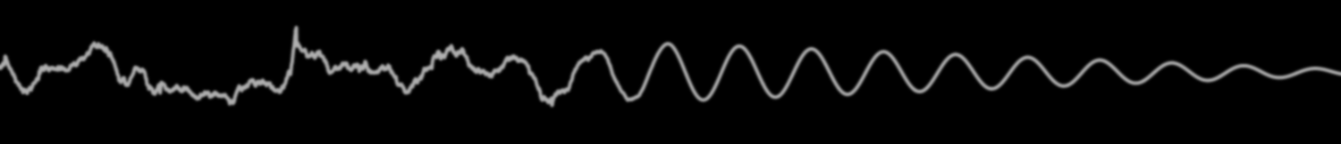
PhD Defense
Understanding Vehicle-Bridge Interaction through Field Measurements and Model-Based Simulations
John B. Braley
Department of Civil & Environmental Engineering
School of Engineering
Rutgers, The State University of New Jersey
April 18, 2019

Slide 2
Research Need
State of US Bridges *
Majority approaching or exceeding design life
$123 billion required
70 million projected population growth by 2045
40% increase in freight volume by 2045
Stewardship Objectives
Continued performance of existing bridges
Improved performance of new bridges
Informed resource allocation
Required Knowledge
Realistic demands
Factors affecting performance
Bridge deterioration
* 2017 ASCE Infrastructure Report Card
Beyond Traffic 2045

Slide 3

State of Practice
Live load demands principally consist of truck loads
Static analysis prescribed
Dynamic component reduced to “amplification” factor
Question: Is this simplification adequate?
VS
m
m
m
m
m
m

Slide 4
Outline
State of Practice
Case Structure
Lessons Learned in VBI Modeling
Simplified Model
Influential Parameters & Mechanisms
Applications in VBI
Smoothing
Traffic & Truck Platoons

Slide 5

Dynamic Amplification Factors
Static loads used in highway bridge design and evaluation
Amplification factors to account for additional load effect from VBI applied to loading model
Two Definitions:
$IM=\frac{Dynamic Response−Static Response}{Static Response}$
$DAF=\frac{Dynamic Response}{Static Response}$
$LL=\left(1+IM\right)∗R_{sta}$ or $LL=DAF∗R_{sta}$

Slide 6
Dynamic Amplification in Codes
Different countries use different factors
Range from 0.05 to 0.40 (AASHTO: 0.33)
Dependent on:
road roughness, no. axles, 1st natural freq, span length
Developed through surveys of existing bridge stock in the 1950s and 1980s
More recent experimental evaluations of IM’s
High variability
Not uncommon to exceed prescribed value

Slide 7
Shortcomings with Experimental Research
Many of the larger studies found bridges with amplification factors between 1.5 and 2, and have identified some of the most influential parameters
However:
Even the largest studies face the issue of whether the studied sample set is representative or comprehensive of the entire bridge population (e.g. Study of 200 bridges in Switzerland consisted mostly of concrete bridges)
Furthermore, the studies often consider too few parameters to fully understand the conditions resulting in amplification issues
These studies have failed to characterize the mechanisms that lead to large dynamic amplification and they offer no quantitative relationships

Slide 8
Shortcomings with Analytical Research
Analytical tools (simulation) provide the ability to investigate the mechanisms driving VBI and amplification. Several analytical studies have echoed the general conclusions of the experimental studies. (e.g. road roughness is a very important parameter)
However:
It is only recently, that software and computing power have made large scale simulation studies possible.
Therefore there is again the issue of small sample sizes and too few parameters investigated
Furthermore, there is little assurance the models are capable of modeling VBI and thus conclusions have been limited to qualitative relationships.

Slide 9
Knowledge Gaps & Vulnerabilities
Dynamic effect of traffic on highway bridges is poorly understood
Inadequacy of current codes has been demonstrated by field experiments (i.e. outliers)
Simulation studies on influential parameters have failed to reach actionable conclusions
Interdependency of influential parameters has been largely overlooked
Established methodologies were developed through statistical means
How has the bridge population changed?
How has traffic changed?
Can a dynamic factor adequately account for VBI?
Effect of truck platoons on highway bridges
Research on railway bridges suggests the repetitive loading of truck platoons can excite bridge dynamics and may lead to amplified bridge response
Notes:
Field experiments are limited to the population subset and only serve to demonstrate shortcomings, rather than propose improvements
Simulations have been mostly with simplified models (i.e. single-line girder),
and with only a few parameters to be investigated
and no assurance that the models are capable of simulating VBI

Slide 10
Objectives
Establish the mechanisms that result in levels of VBI that render the common static live load model unconservative,
For the cases identified in (1) develop and validate a practical approach to estimating the effects of truck loads inclusive of VBI, and
Identify bridge vulnerabilities associated with truck platooning and make recommendations related to how VBI should be estimated and mitigated.
Notes:
Difference from previous studies:
Field testing and model calibration will ensure the models are capable of simulating VBI
All influential parameters will be examined simultaneously
Develop actionable conclusions

Slide 11
Inductive Research Strategy
Demonstrate Comprehensive Understanding of VBI
Phase 1 – Identify and characterize “test” structure through field testing. Develop FE models.
Phase 2 – Perform detailed characterization of VBI on test structure. Refine FE model.
Phase 4 – Identify methods for estimating and predicting dynamic amplification
Phase 5 – Investigate VBI mechanisms with sensitivity analysis of FE model parameters
Phase 6 – Leverage VBI simulation tools to address some of the challenges facing bridges associated with dynamic response.
Develop Practical Tools & Actionable Knowledge of VBI

Slide 12
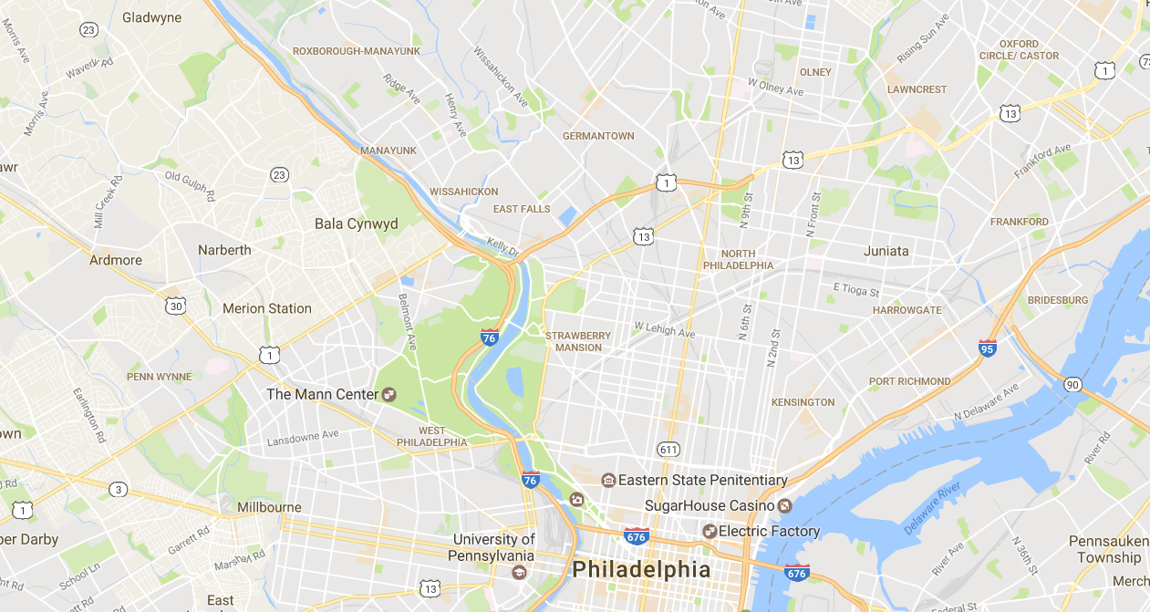
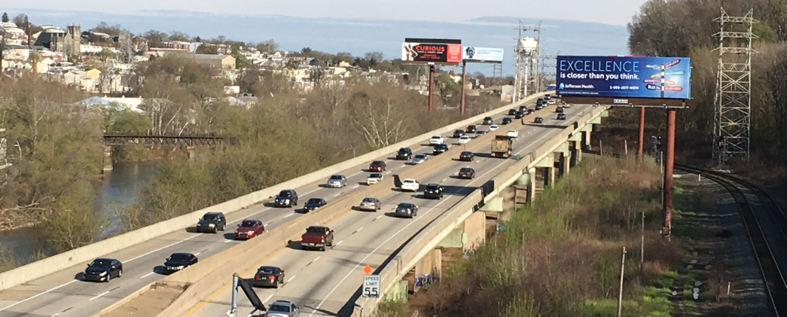
Introduction to Test Structure
Notes:
Rebuilt 1986
Original structure 1952

Slide 13
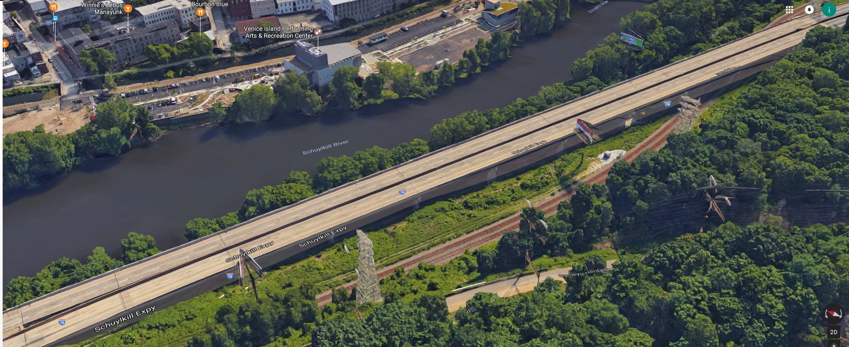
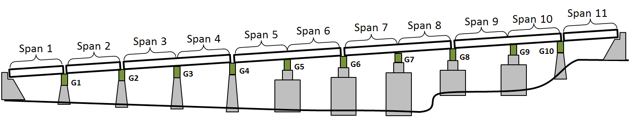
Introduction to Test Structure
Span 10
Span 8
Span 9
Span 6
Span 7
Span 4
Span 5
WESTBOUND
Span 2
Span 3
EASTBOUND
Span 1

Slide 14
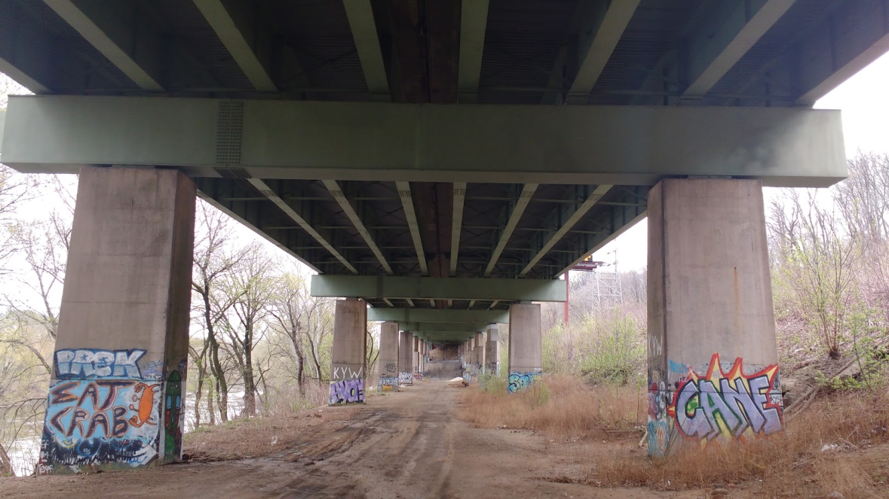
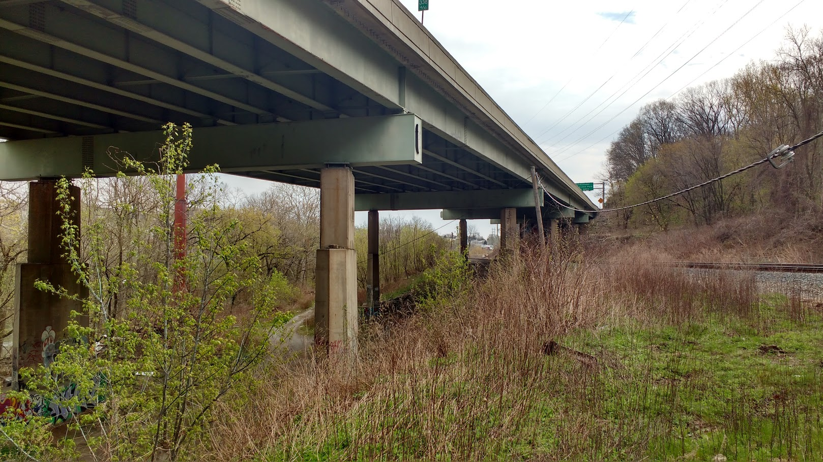
Introduction to Test Structure
Notes:
Plate girders are ~6ft deep

Slide 15
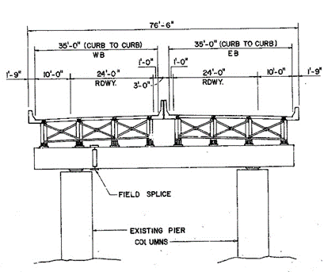
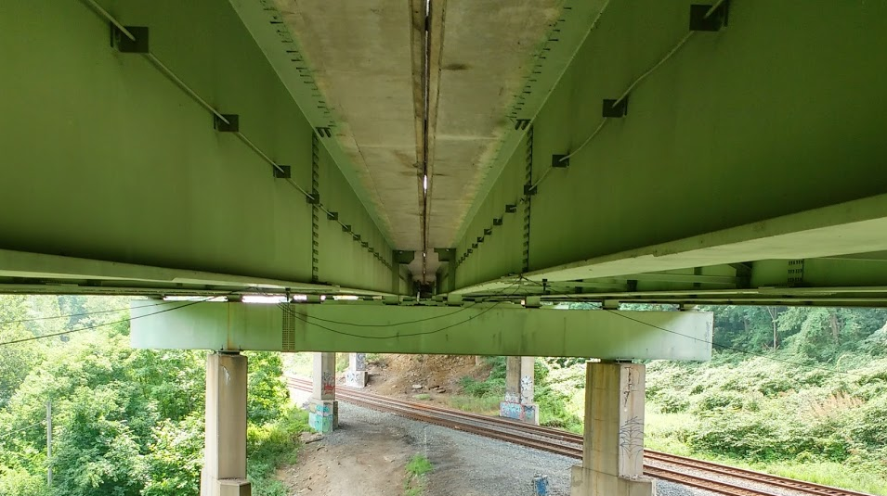
Introduction to Test Structure

Slide 16
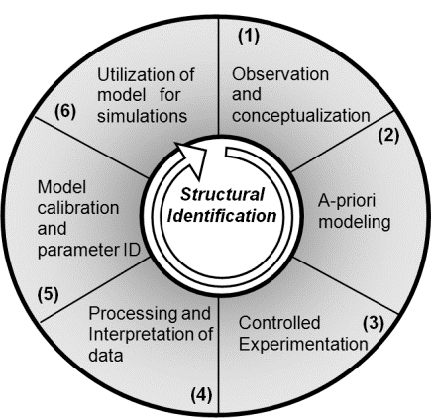
Framework for Investigating Test Structure

Slide 17
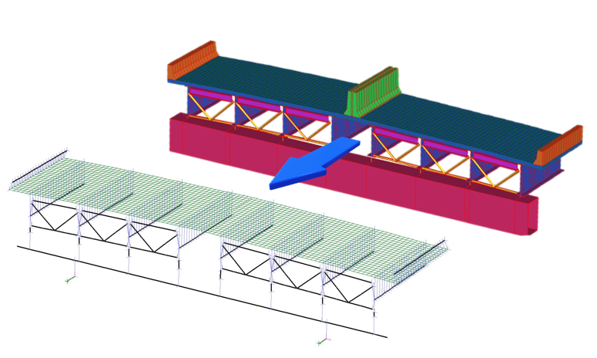
FE Modeling of Test Structure

Slide 18
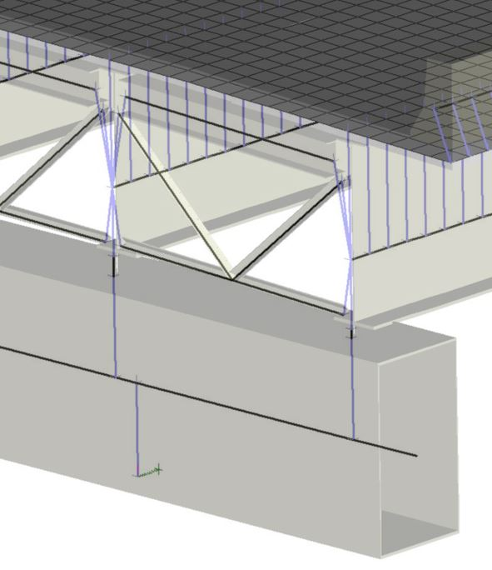
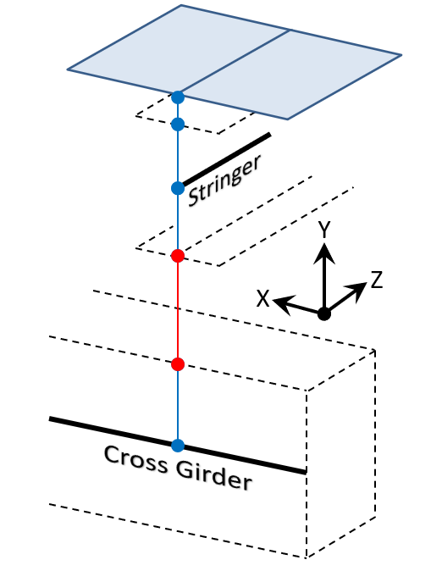
FE Modeling of Test Structure
Pedestals & Bearings

Slide 19
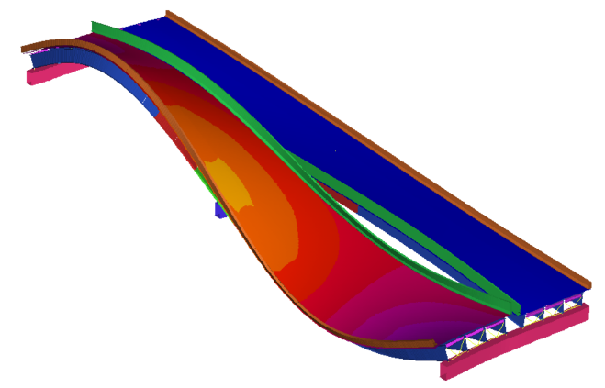
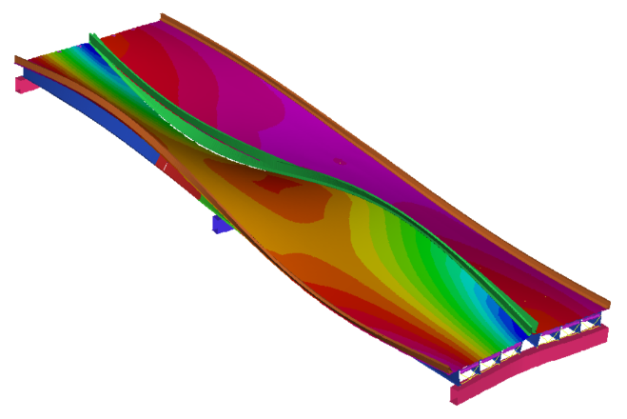
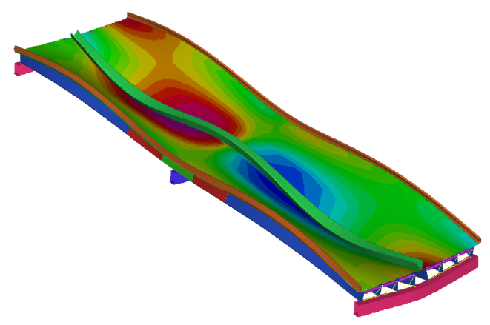
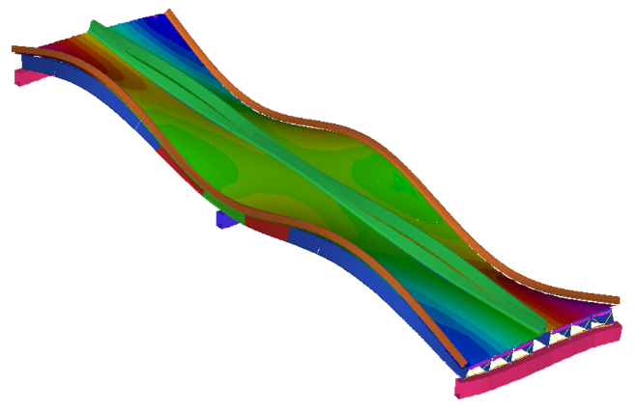
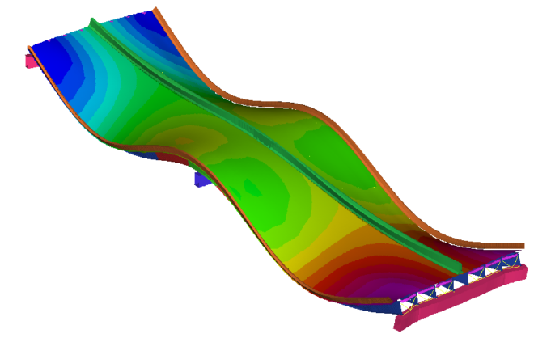
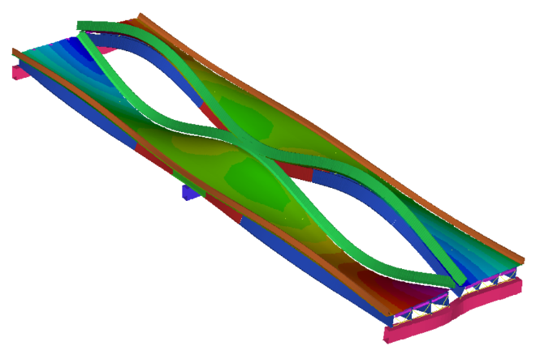
FE Modeling: Preliminary Mode Shapes
2.37 Hz
2.73 Hz
3.71 Hz
4.22 Hz
4.25 Hz
4.58 Hz

Slide 20
Phase 1 Testing: Objectives
Primary Goal:
Identify which portions of the structure were experiencing the greatest vibration and should receive further testing.
Objectives:
Locate those spans which experience the largest vibrations
Identify in which direction the largest vibrations are occurring

Slide 21
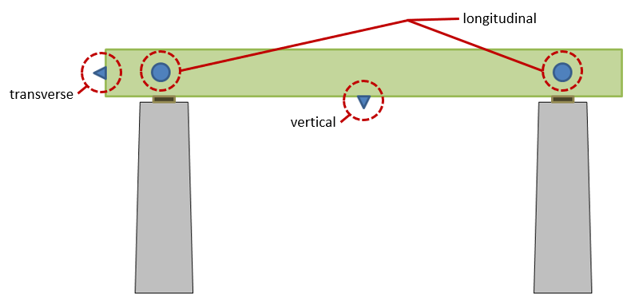
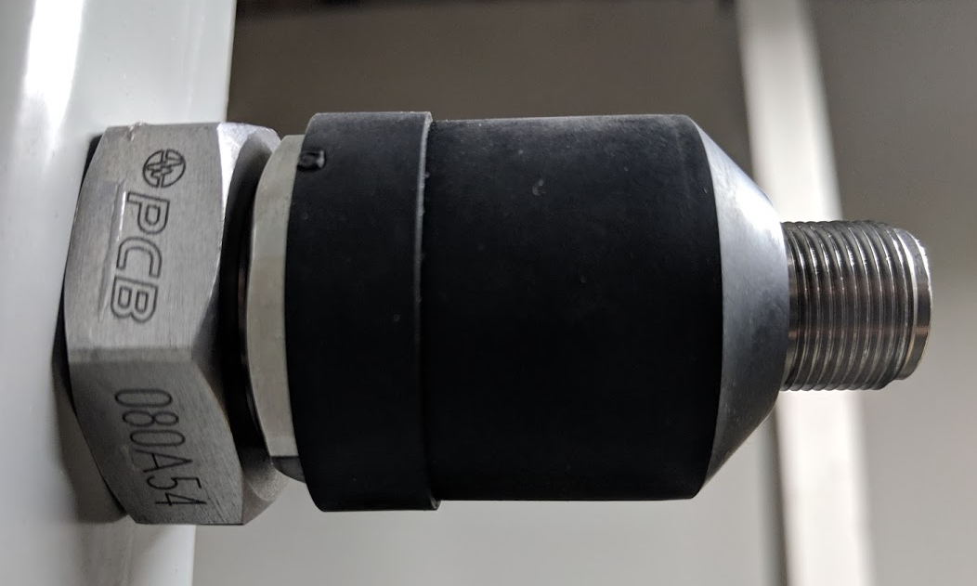
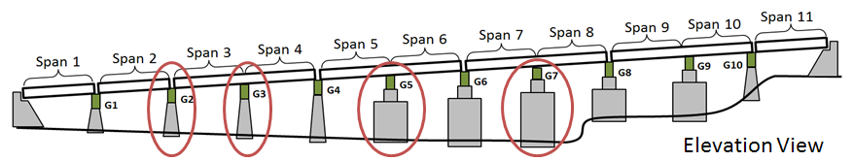
Phase 1 Testing: Instrumentation Plan

Slide 22
Phase 1 Testing: Results

Slide 23
Phase 2 Testing: Objectives
Primary Goals:
Characterize the superstructure and quantify the operational dynamic amplification.
Objectives:
Identify the superstructure’s global (operational) modes of vibration.
Capture operational vibrations and strains at critical locations and locations of maximum response

Slide 24
Phase 2 Testing: Preliminary FE Mode Shapes
2.37 Hz
2.73 Hz
3.71 Hz
4.22 Hz
4.25 Hz
4.58 Hz

Slide 25
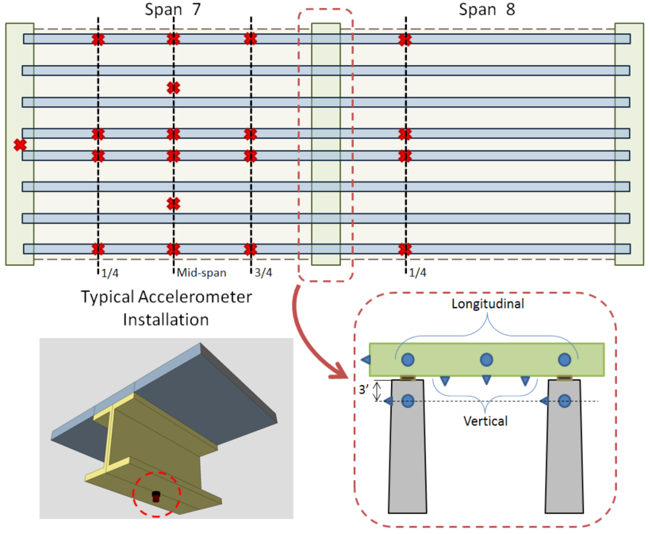
Phase 2 Testing: Accel Instrumentation Plan

Slide 26
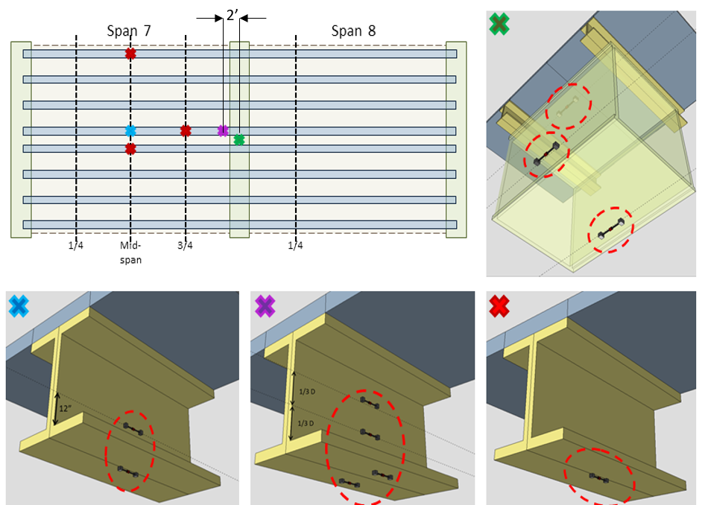
Phase 2 Testing: Strain Instrumentation Plan

Slide 27
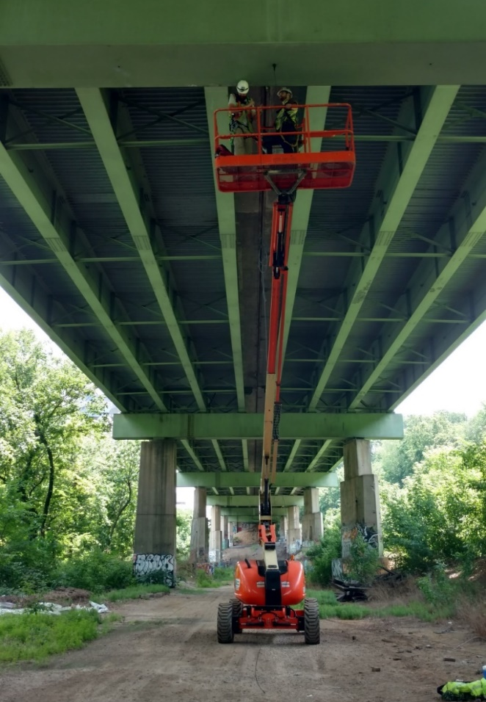
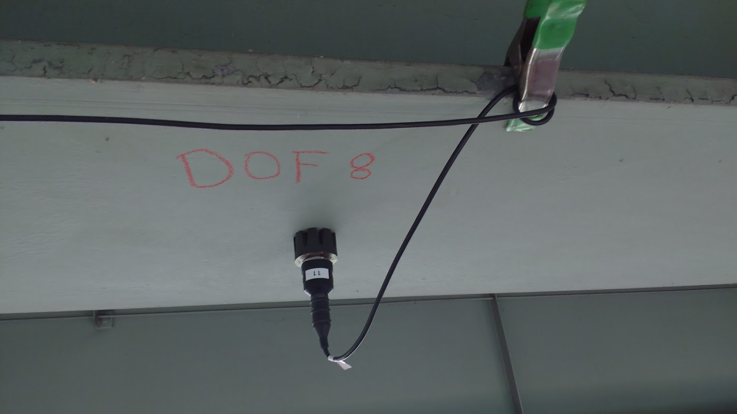
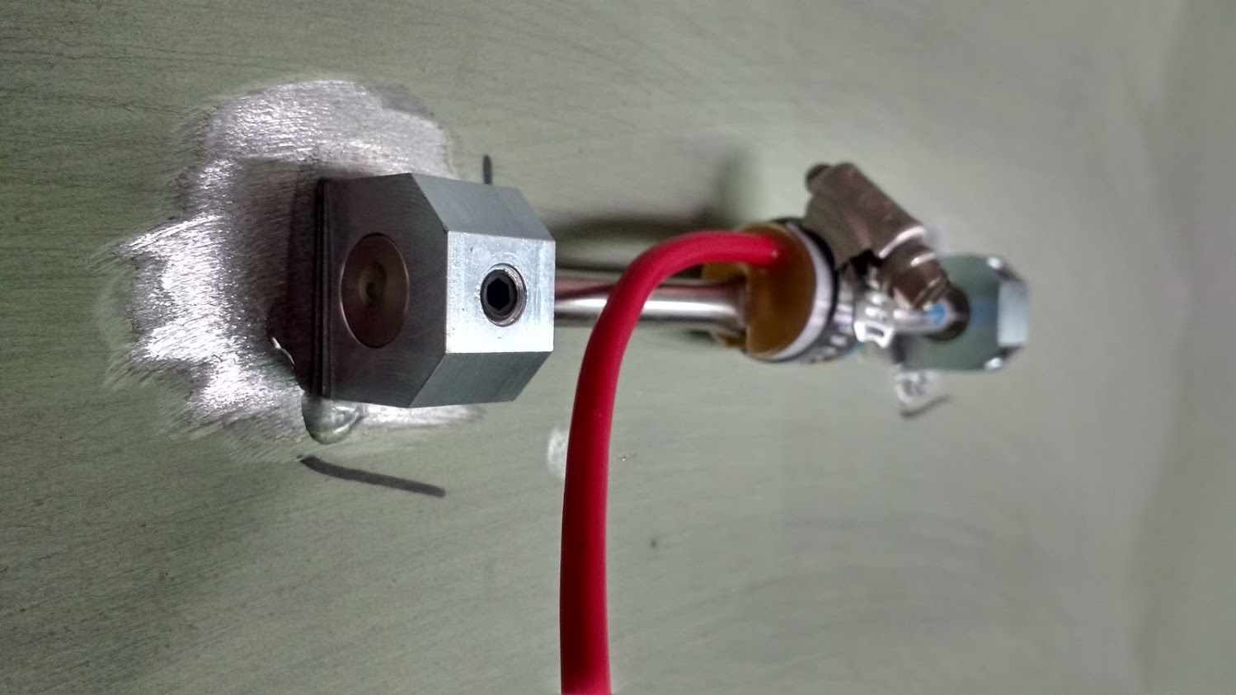
Phase 2 Testing: Test Activities
Notes:
2 days install

Slide 28
Phase 2 Testing Results: Acceleration for Typical Event
Notes:
Elliptic filter with 20 Hz cutoff, 40db stopband attenuation, 0.5 dB pass-band ripple

Slide 29
Phase 2 Testing Results: High Acceleration Events
Notes:
High acceleration, but so does a dropped ball bearing produce. We care about low frequency

Slide 30
Phase 2 Testing Results: Bridge Acceleration Frequency Content
Notes:
Welch’s PSD estimate

Slide 31


Phase 2 Testing Results: Acceleration to Displacement
$$\left.Acceleration= \ddot{V}=A∗sin⁡(ωt\right)$$
$$Displacement= −\frac{A}{ω^{2}}∗\sin\left(ωt\right)= −\frac{Acceleration}{ω^{2}}$$
FRF_{A}
FFT
FRF_{D}
iFFT(FRF_{D})
Disp.
ω_{n}²
Notes:
Conclusion: The high accelerations are inducing appreciable bridge deformation
Limitations: Sensors are AC coupled, do not accurately capture content below 0.5Hz. Therefore, only included frequency components above 0.5Hz

Slide 32
Phase 2 Testing Results: Strain Time History
Notes:
Strain… more direct measure of what the material is experiencing (which is the basis for nearly all performance metrics).
200 microstrain – 6 ksi

Slide 33
Phase 2 Testing Results: Strain Amplification by Filtering
Notes:
Elliptic filter with 1.5 Hz cutoff frequency.
Apparent DAF near 2.0.

Slide 34
Phase 2 Testing: Objectives
Primary Goals:
Characterize the superstructure and quantify the operational dynamic amplification.
Objectives:
Capture operational vibrations and strains at critical locations and locations of maximum response
Identify the superstructure’s global (operational) modes of vibration.

Slide 35

Phase 2 Testing Results: Modal Parameter Identification
CPSD
SVD
ψ_{f}
Cross Power Spectral Density
$$\left.H_{f}=\left[ψ\right]∗\left[Λ\right]∗[L\right]$$
Locate peaks in singular values
Evaluate ψ at largest singular value
Notes:
Perform CPSD for all channels (to obtain square FRF matrix)
SVD to decompose into mode shapes (mode shape, singular values (i.e. rank, modal scaling), input (unknown, unused)).
Identify frequencies from singular value maxima
Mode shapes from left singular vector

Slide 36
Phase 2 Testing Results: Modal Parameter Identification

Slide 37
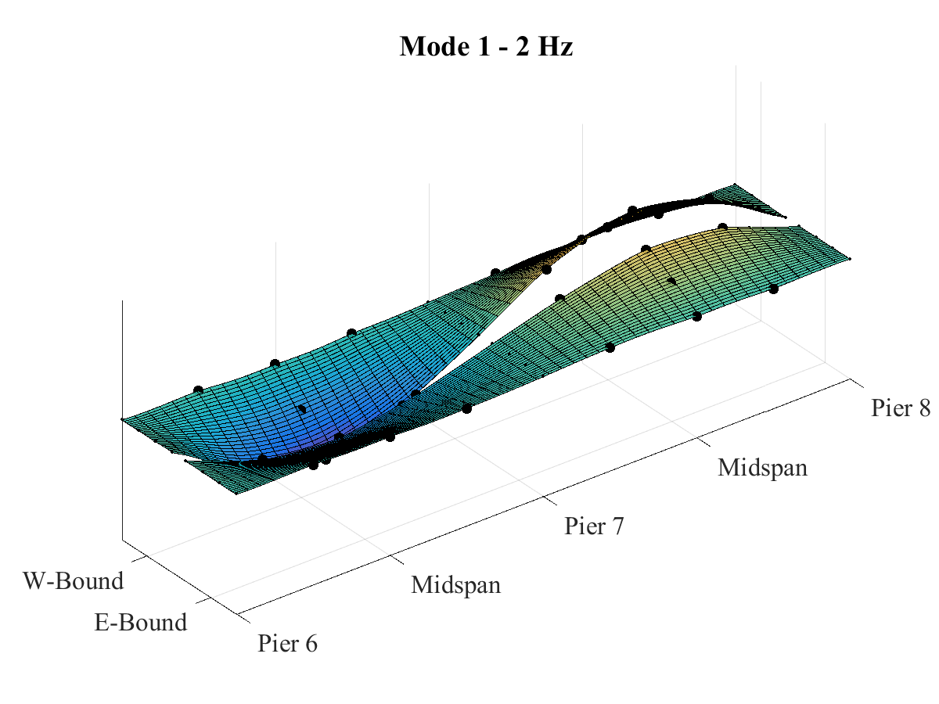
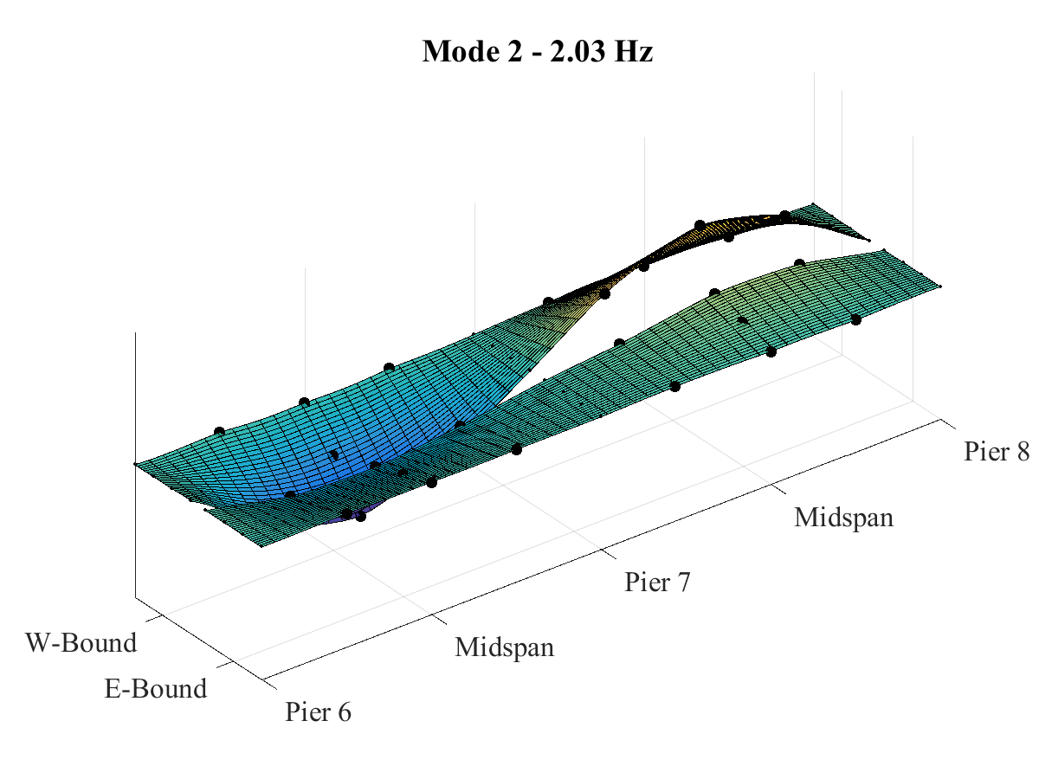
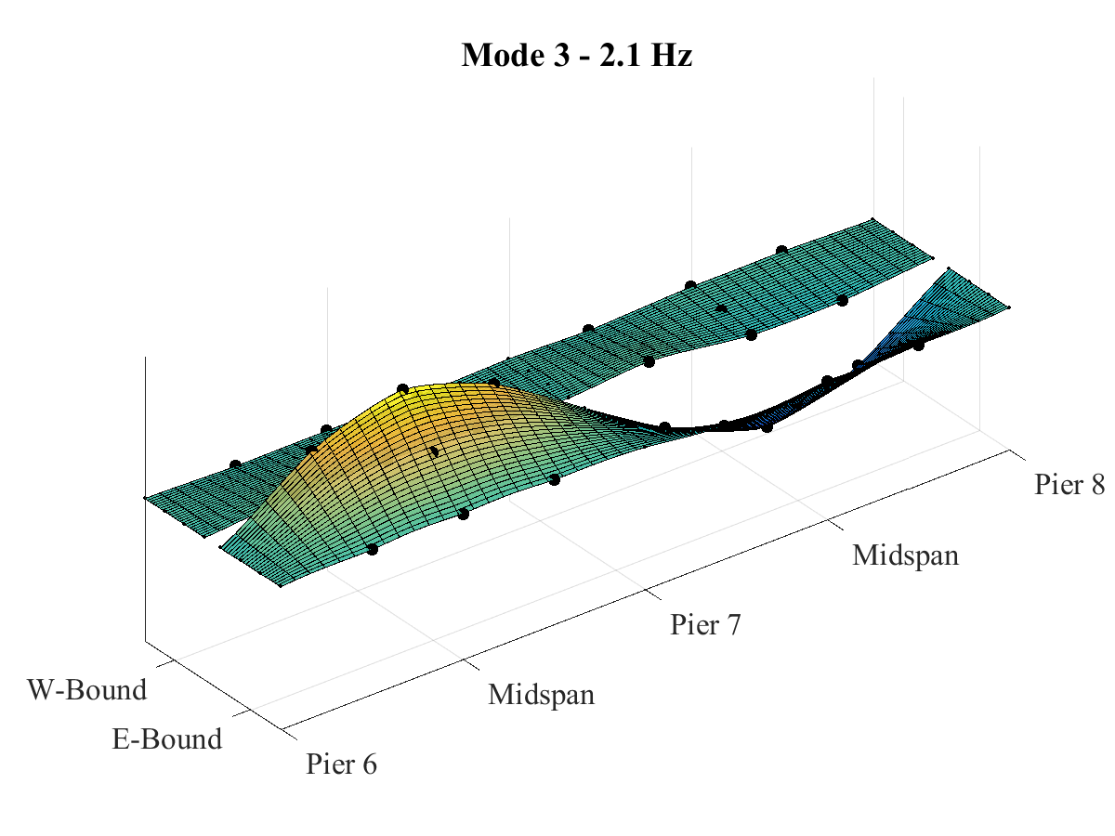
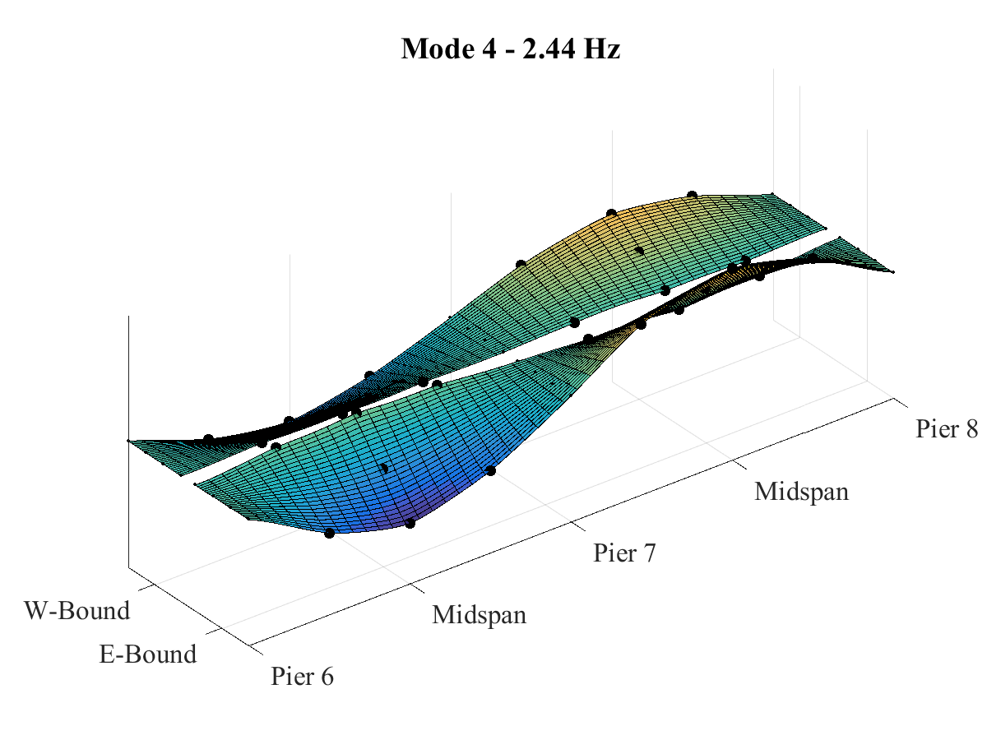
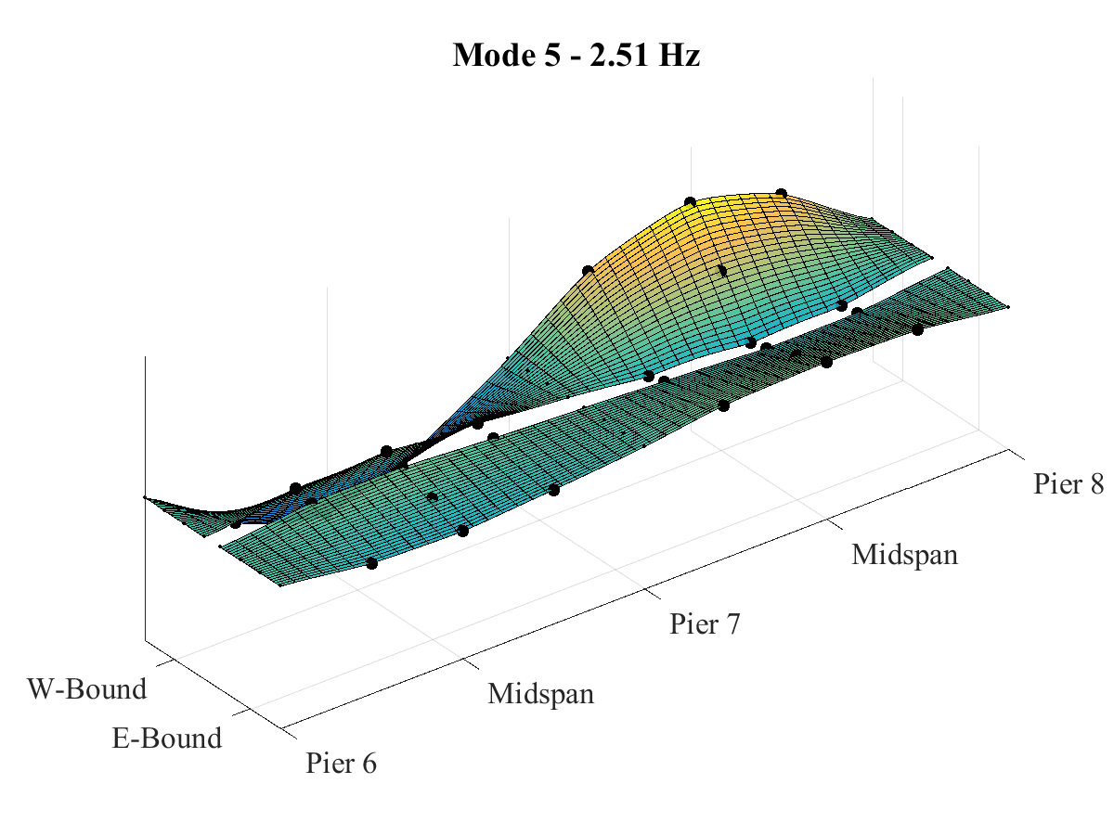
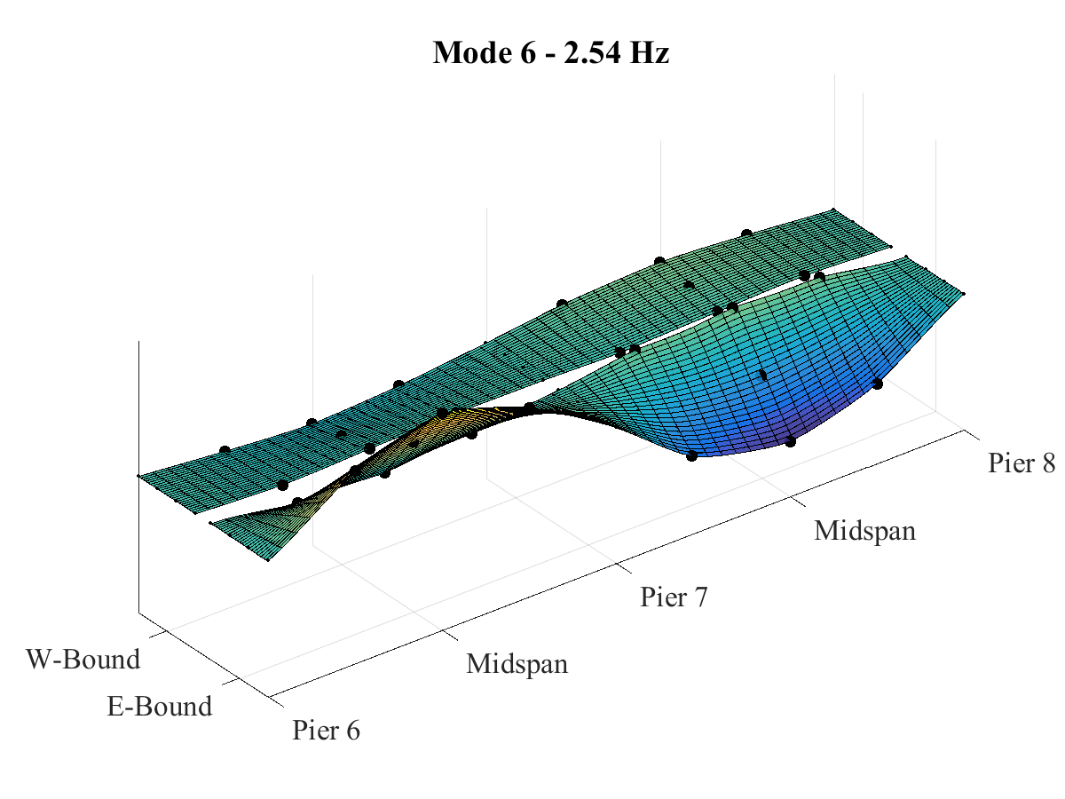
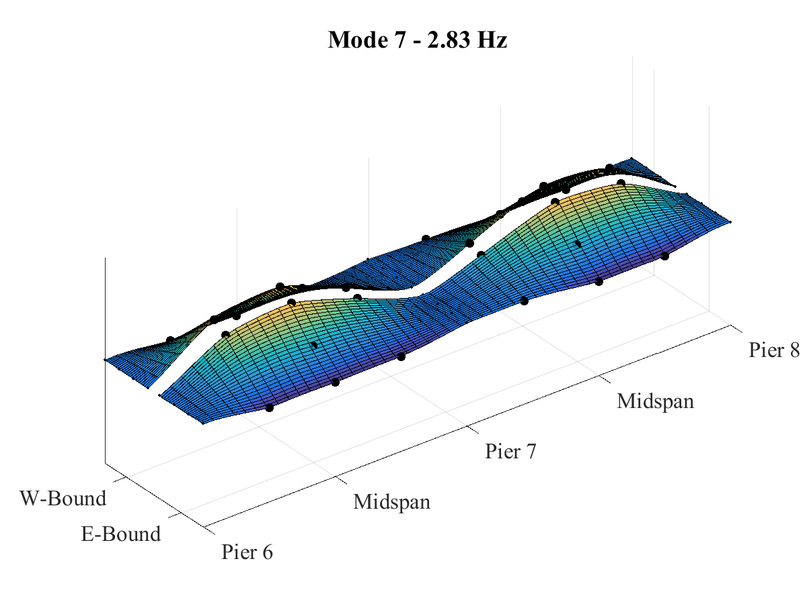
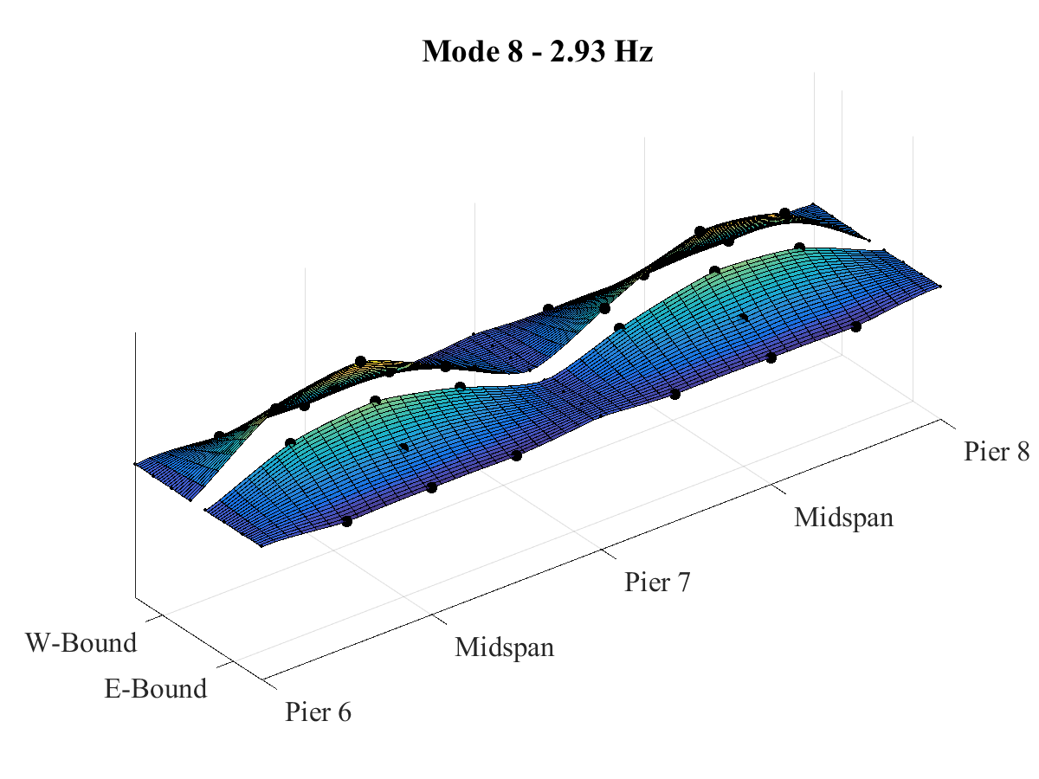
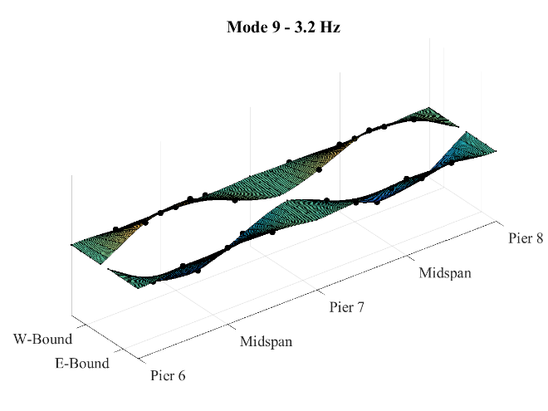
Phase 2 Testing Results: Modal Parameter Identification

Slide 38
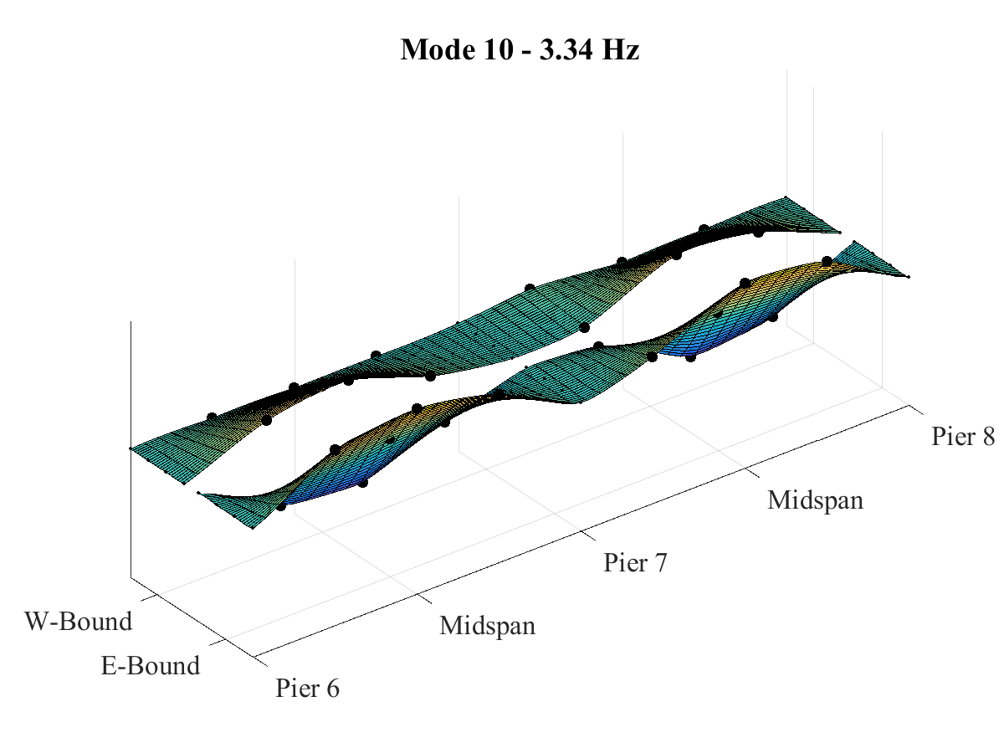
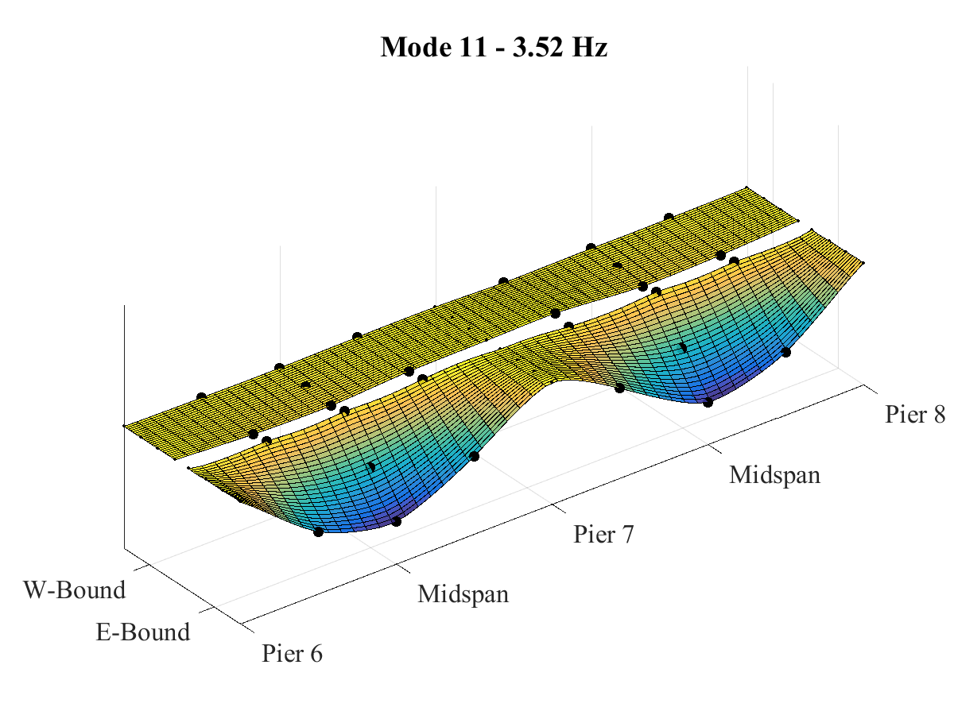
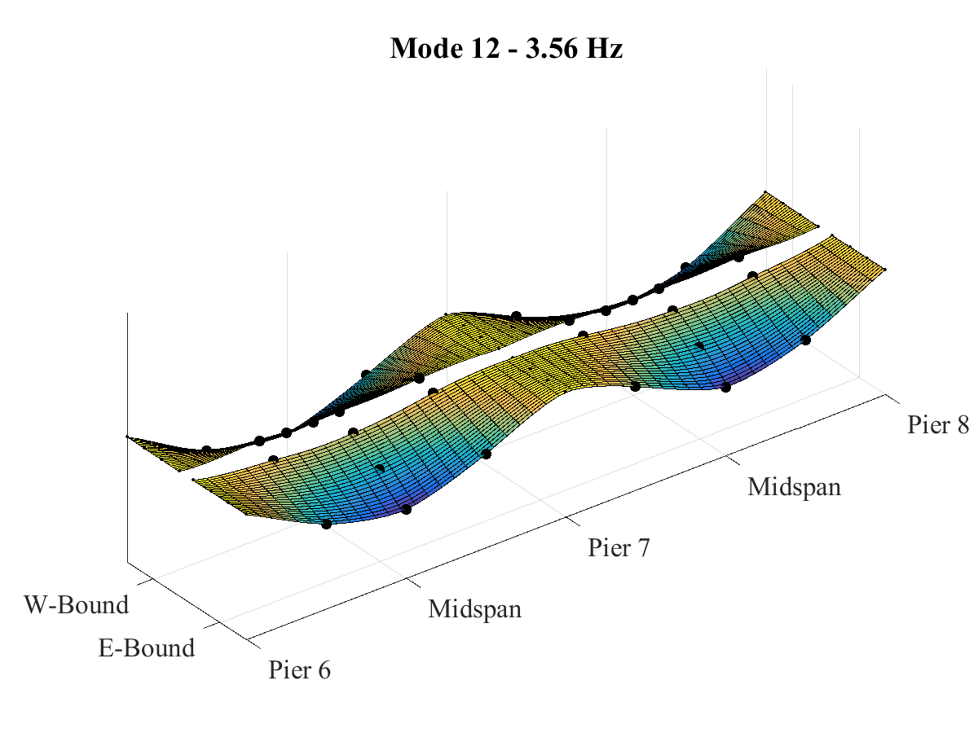
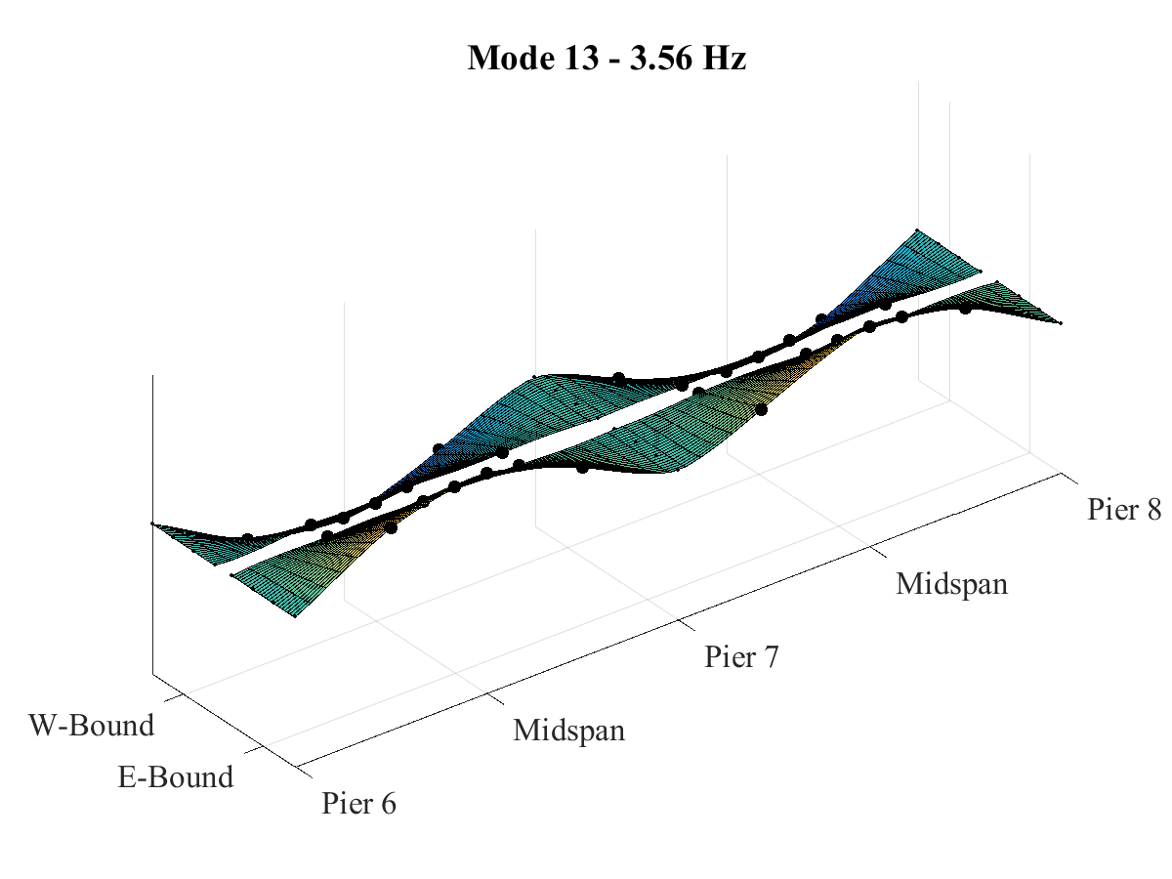
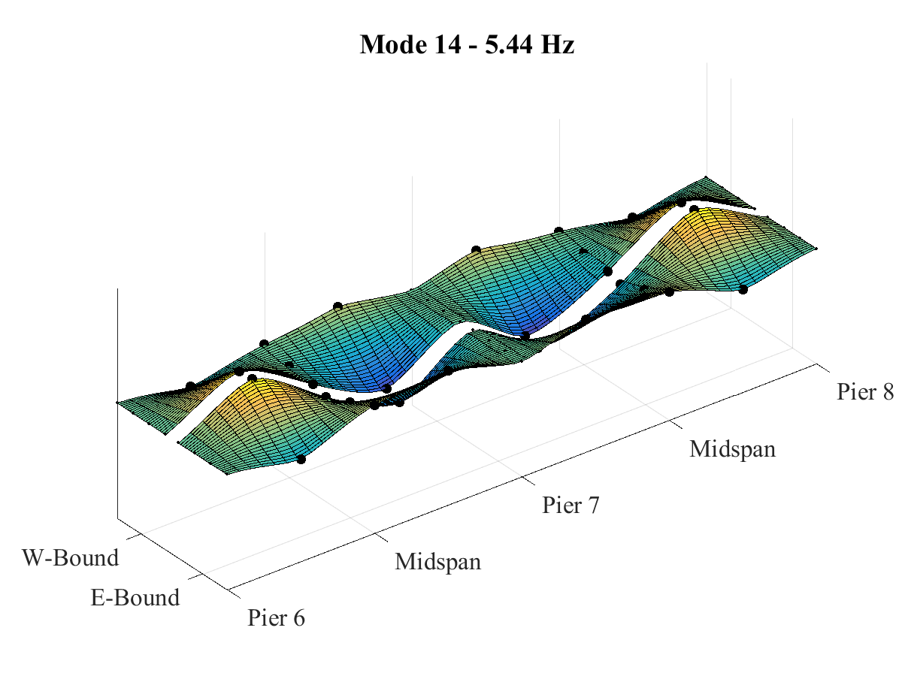
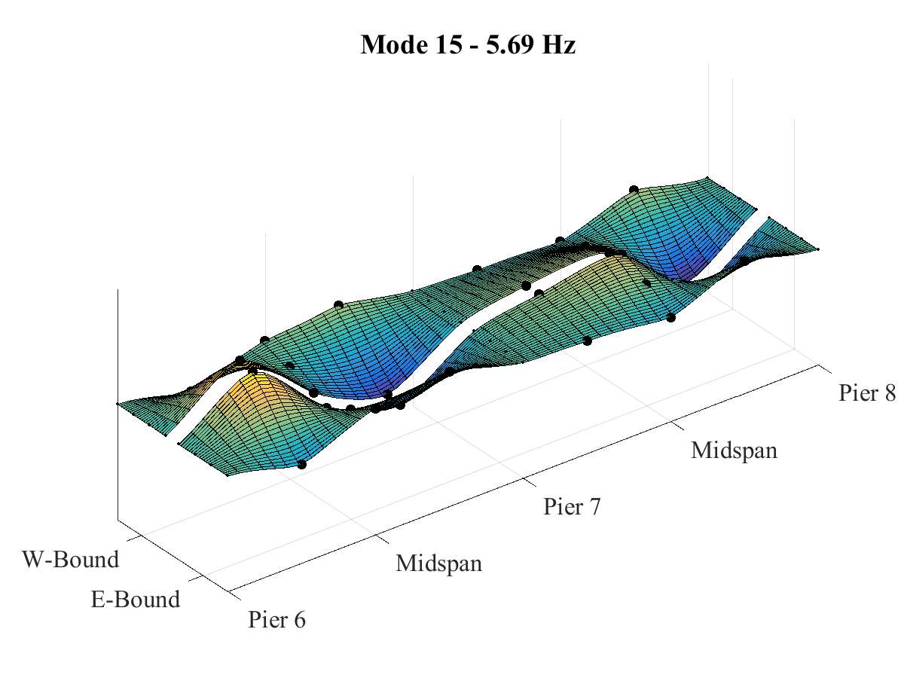
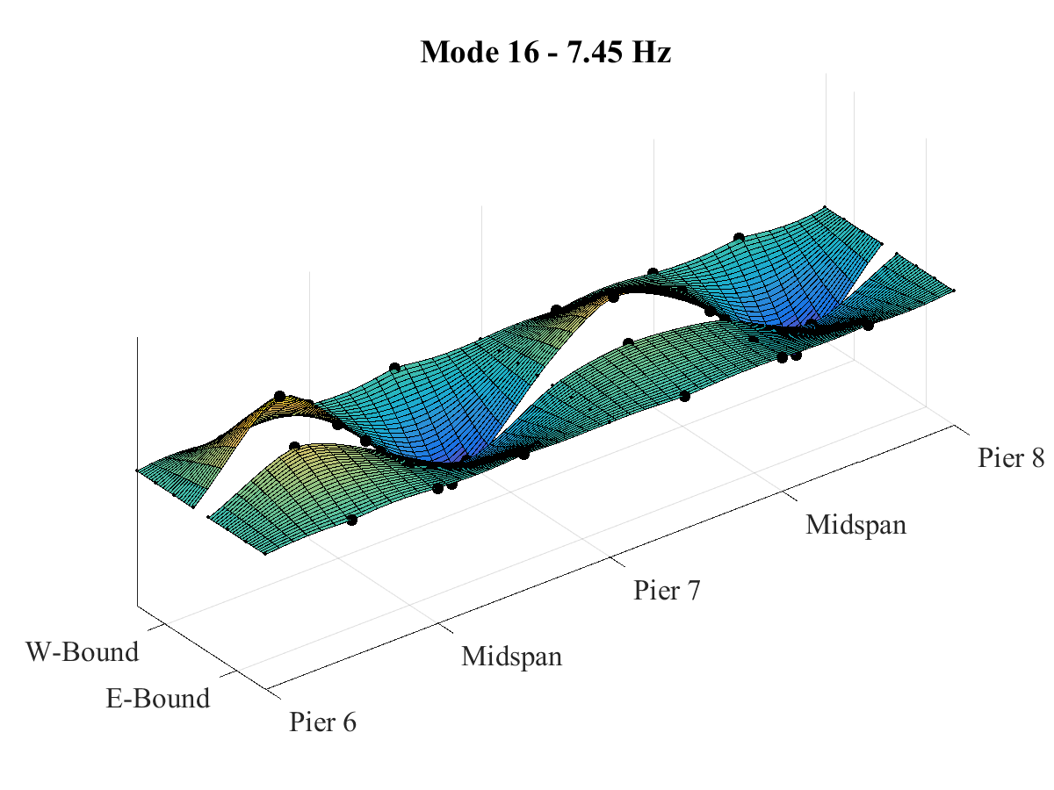
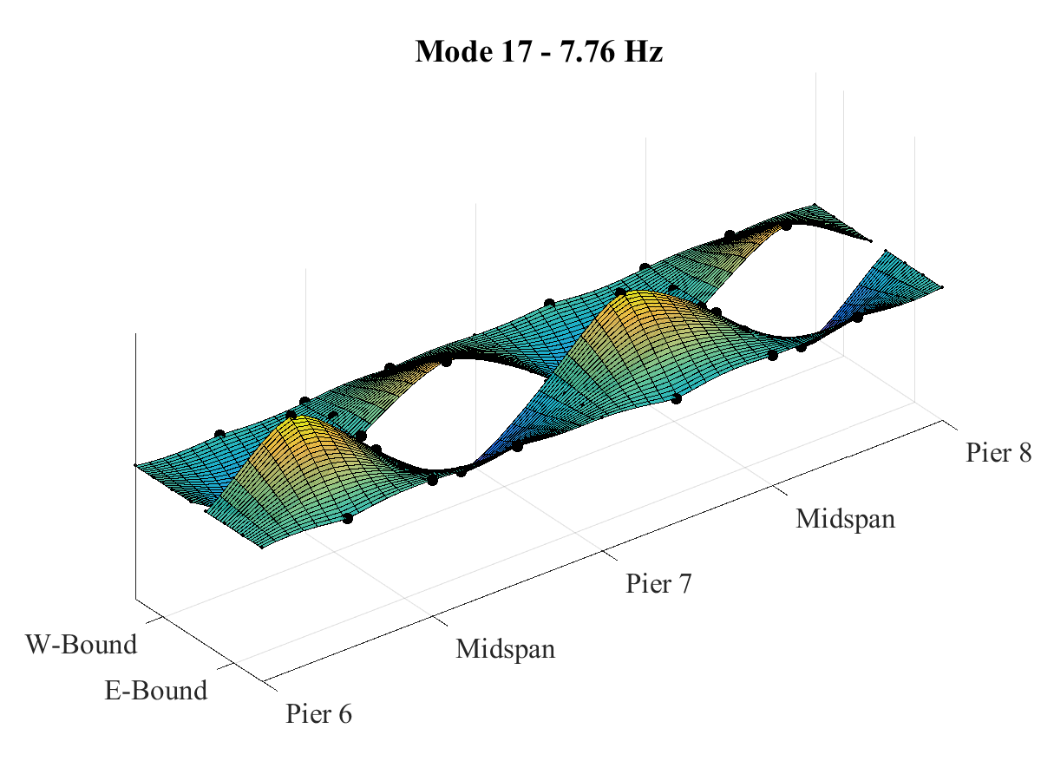
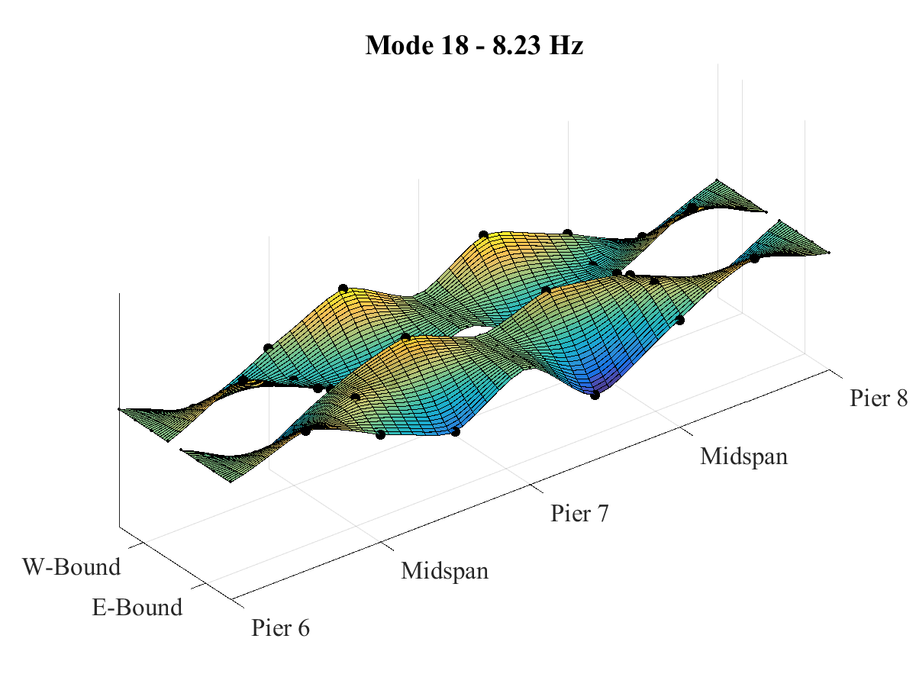
Phase 2 Testing Results: Modal Parameter Identification

Slide 39
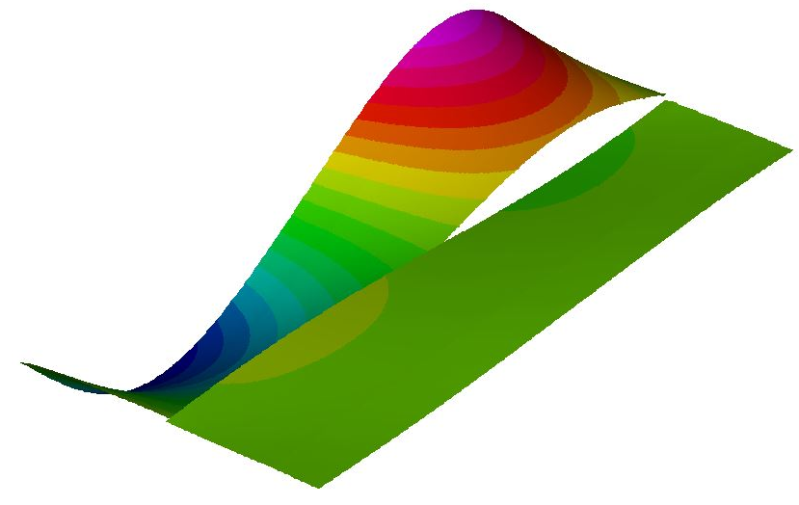
Phase 2 Testing Results: Model Calibration
 | Initial Values | Calibrated Values | units
Stiffness of interior barriers (modulus of elasticity) | 3982736 | 5 | lb/in²
Material density of interior barriers | 0.086705 | 0.104047 | lb/in³
Material density of exterior barriers | 0.086705 | 0.104047 | lb/in³
Elastomeric bearing lateral stiffness | 1.00E+09 | 4.00E+05 | lb/in
Continuity of exterior barriers over continuous support

Slide 40
Phase 2 Testing Results: Model Calibration
 | Exp. | Prelim. FEM | % diff | FEM (cal.) | % diff
Mode 1 | 2.00 | 2.73 | 36.5% | 2.00 | <0.1%
Mode 2 | 2.03 | 2.37 | 16.7% | - | -
Mode 3 | 2.10 | 3.22 | 53.3% | 2.02 | -3.8%
Mode 4 | 2.44 | - | - | 2.28 | -6.6%
Mode 5 | 2.51 | - | - | - | -
Mode 6 | 2.54 | 3.77 | 48.4% | 2.33 | -8.3%
Mode 7 | 2.83 | 3.71 | 31.1% | 3.06 | 8.1%
Mode 8 | 2.93 | - | - | - | -
Mode 9 | 3.20 | - | - | 3.17 | -0.9%
Mode 10 | 3.34 | 4.58 | 37.1% | - | -
Mode 11 | 3.52 | - | - | - | -
Mode 12 | 3.56 | 4.25 | 19.4% | 3.68 | 3.4%
Mode 13 | 3.56 | - | - | 3.68 | 3.4%

Slide 41
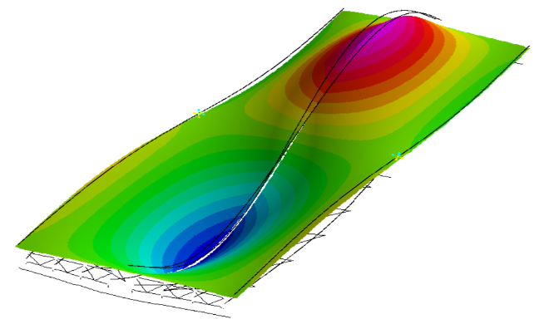
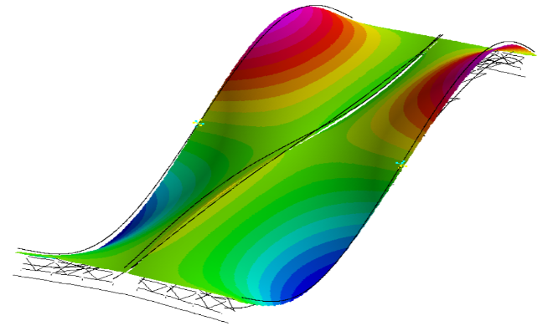
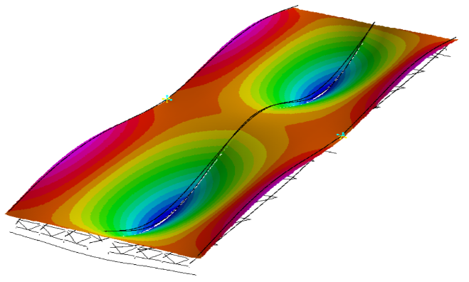
Phase 2 Testing Results: Model Calibration
Mode 1
Mode 4
Mode 7

Slide 42
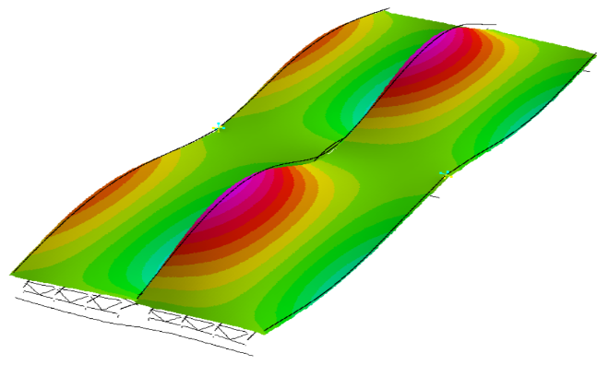


Phase 2 Testing Results: Model Calibration
Mode 9
Mode 12
Mode 13

Slide 43
Phase 2 Testing Results: Leveraging FEM
 | IM = 0.33 |  | IM = 0.75
 | Strength I | Service II | Strength I | Service II
Girder 4 | 1.60 | 1.73 | 1.21 | 1.32
Girder 5 | 1.86 | 1.98 | 1.41 | 1.50
Sources of Conservatism
 | Design | FEM
Distribution Factor | 0.91 | 0.79
Design Load | HL-93 | 204 kip permit load

Slide 44
Phase 2 Testing: Conclusions
This structure is experiencing dynamic amplification in excess of 1.75.
Refined load ratings reveal that there is sufficient reserve capacity to handle the increased dynamic amplification.
The structure’s dominant operational modes of vibration are between 2 and 4 Hz.
The calibrated FE model had parameter values within reasonable bounds indicating that there are no structural abnormalities contributing to the vibration issues.
This phase of testing was unable to identify the cause of the vibrations.

Slide 45
Phase 3 Testing: Objectives
Primary Goal:
Identify the driving mechanisms behind the observed high dynamic amplification.
Objectives:
Record conditions resulting in large vibrations/amplification
Record data appropriate for validating VBI models
Characterize relationship between bridge responses and vehicle parameters
Identify structural attributes that are influential to large vibrations
Determine the influence of vehicle location (on the bridge) on vehicle response

Slide 46


Phase 3 Testing: Instrumentation Plan

Slide 47


Phase 3 Testing: Instrumentation Plan

Slide 48


Phase 3 Testing: Test Activities
Wheel Location | Weight
Passenger Front | 6960 | lb
Passenger Middle | 11680 | lb
Passenger Rear | 12000 | lb
Driver Front | 6500 | lb
Driver Middle | 12180 | lb
Driver Rear | 12080 | lb
Total | 61400 | lb
36 accelerometers installed on bridge
6 accelerometers installed on truck
Synchronization provided by GPS time (±100 ns)
14 Truck runs across bridge
Run # | Lane | Direction of Travel | Average Speed (mph) | Traffic Conditions
1 | L | WB | 60 – 30 | Heavy
2 | R | EB | 35 | Light
3 | R | WB | 42 | Moderate
4 | R | EB | 25 | Moderate
5 | L | WB | 40 – 0 | Heavy
6 | L | EB | 40 | Light
7 | L | WB | 15 | Heavy
8 | L | EB | 47 | Light
9 | L | WB | 58 | Light
10 | R | EB | 20 | Light
11 | R | WB | 10 | Moderate to light
12 | L | EB | 40 | Light
13 | R | WB | 35 | Light
14 | R | EB | 40 | Light

Slide 49
Phase 3 Testing Results: Truck Accels High Freq. Content

Slide 50

Phase 3 Testing Results: Truck Acceleration
 | Before Bridge (A) | On Bridge (B) | % Increase
Driver Front | 0.042 g | 0.101 g | 140.0%
Driver Rear | 0.078 g | 0.244 g | 213.2%
Passenger Front | 0.040 g | 0.095 g | 134.8%
Passenger Rear | 0.076 g | 0.231 g | 203.4%
Notes:
Filtered with 20Hz cut-off

Slide 51
Phase 3 Testing Results: Truck Acceleration PSD

Slide 52
Phase 3 Testing Results: Truck Acceleration PSD
PSD computed with data from truck to bridge site
Welch’s improved PSD estimator
(4) 10-second segments
25% overlap

Slide 53
Phase 3 Testing Results: Truck Acceleration PSD
RMS performed on filtered truck acceleration data over the time period when the truck was on the bridge.
Plotted values are the average RMS values for the rear accelerometers

Slide 54
Phase 3 Testing Results: Bridge Acceleration
Run 6

Slide 55
Phase 3 Testing Results: Bridge Acceleration
Run 6

Slide 56
Phase 3 Testing Results: Bridge Acceleration
Run 6

Slide 57
Phase 3 Testing Results: Bridge Acceleration
Span 2
Avg. Span 3 & 4
East-Bound Right-Lane | Girder 8
East-Bound Left-Lane | Girder 5
West-Bound Right-Lane | Girder 1
West-Bound Left-Lane | Girder 4

Slide 58
Phase 3 Testing: Conclusions
A single truck is capable of inducing vibrations in the bridge that lead to dynamic amplification of bridge responses.
The acceleration of the truck increases immediately after entering the bridge as low frequency (1.5-4Hz) vibrations are excited.
The acceleration of the bridge increases very soon after the truck enters the respective span as low frequency (2-4Hz) vibrations are excited.
The magnitude of vehicle vibrations increases with increased vehicle (horizontal) speed.
The magnitude of bridge vibrations increases with increased vehicle (horizontal) speed.
The lane and direction of travel of the truck does not have a significant influence on the magnitude of either vehicle or bridge vibrations.
Simulation is required to provide understanding of the mechanisms and influential parameters associated with dynamic amplification.

Slide 59


VBI Model Validation
Experimental and Calibrated FEM Natural Frequencies (Hz)
 | Exp. | LUSAS FEM | % diff
Mode 1 | 2.00 | 2.033 | 1.5%
Mode 2 | 2.03 | - | -
Mode 3 | 2.10 | 2.072 | 1.4%
Mode 4 | 2.44 | 2.493 | 2.0%
Mode 5 | 2.51 | - | -
Mode 6 | 2.54 | 2.496 | 1.6%
Mode 7 | 2.83 | 2.821 | 0.4%
Mode 8 | 2.93 | - | -
Mode 9 | 3.20 | 3.137 | 1.9%
Mode 10 | 3.34 | - | -
Mode 11 | 3.52 | - | -
Mode 12 | 3.56 | 3.628 | 2.0%
Mode 13 | 3.56 | 3.629 | 2.0%
PEB Model

Slide 60
VBI Model Validation
Mid Span 3 (FEM)
Vehicle Model

Slide 61

VBI Model Validation
 | Value | Units
ks | 30000 | lb/in
cs | 241 (7%) | lb-s/in
ms | 98.42 | lb-s²/in
mu | 20.72 | lb-s²/in

Slide 62
VBI Model Validation
Span 2
Span 3
Span 7

Slide 63

VBI Model Validation
$$MAE=\frac{1}{n}\sum_{i=1}^{n}{\left|Y_{i}−{\hat{Y}}_{i}\right|}$$
 | Run 3 |  | Run 14
 | MAE_DTW (g) | % MAE_DTW | MAE_DTW (g) | % MAE_DTW
Truck (Avg. Rear) | 0.0224 | 2.40% | 0.029 | 3.53%
Span 2 | 0.0031 | 4.14% | 0.008 | 5.51%
Span 3 | 0.0049 | 4.13% | 0.007 | 4.18%
Span 4 | 0.0049 | 4.67% | - | -
Span 7 | 0.0056 | 7.97% | 0.006 | 6.12%
 | Run 3 |  |  | Run 14
 | Max Exp. | Max Sim. | %Diff. | Max Exp. | Max Sim. | %Diff.
Truck (Avg. Rear) | 0.9352 | 0.6345 | -32.15% | 0.825 | 0.738 | -10.58%
Span 2 | 0.0750 | 0.0890 | 18.58% | 0.137 | 0.210 | 53.61%
Span 3 | 0.1177 | 0.1190 | 1.09% | 0.162 | 0.225 | 38.31%
Span 4 | 0.1055 | 0.1230 | 16.68% | - | - | -
Span 7 | 0.0705 | 0.0926 | 31.48% | 0.100 | 0.168 | 68.84%

Slide 64
VBI Model Validation: Dynamic Time Warping
Warped

Slide 65
VBI Modeling: Dynamic Amplification

Slide 66
VBI Modeling: Conclusions
The VBI modeling and validation efforts succeeded in producing a model that could simulate VBI. The following conclusions were also made.
A validated 3D FE model is capable of simulating bridge-vehicle interaction if roadway profile is included and accurately positioned on the model.
A single degree-of-freedom vehicle model is adequate for simulating VBI and provides a conservative estimate of bridge response.
Simulation results suggest that this structure may experience dynamic amplification even greater than observed, especially at higher speeds.
The large vibrations of the “test” structure may be principally attributed to the roadway profile.

Slide 67

Inductive Research Strategy
Demonstrate Comprehensive Understanding of VBI
Phase 1 – Identify and characterize “test” structure through field testing. Develop FE models.
Phase 2 – Perform detailed characterization of VBI on test structure. Refine FE model.
Phase 4 – Identify methods for estimating and predicting dynamic amplification
Phase 5 – Investigate VBI mechanisms with sensitivity analysis of FE model parameters
Phase 6 – Leverage VBI simulation tools to address some of the challenges facing bridges associated with dynamic response.
Develop Practical Tools & Actionable Knowledge of VBI

Slide 68

VBI Modeling: System Components
The mass of bridge excited by the vehicle-induced forces
The stiffness of the bridge
The mass of the vehicle
The suspension characteristics of the vehicle
The vehicle velocity
The roadway profile accurately positioned on bridge

Slide 69



Estimating Dynamic Amplification: In-Situ
 | Point Force | Distributed (Inertial) Force
Displacement | $$∆=\frac{PL^{3}}{48EI}$$ | $∆=\frac{m_{b}L^{3}A_{max}}{π^{4}EI}$
Stress | $$σ=\frac{PLy}{4I}$$ | $$σ=\frac{m_{b}LA_{max}y}{π^{2}I}$$

Slide 70
Estimating Dynamic Amplification: In-Situ
Displacement and Strain gauges preferred over accelerometers (DC-coupled)
Amplification estimated by filtering
Cut-off frequency < nat. freq.; > freq. of loading
Phase shift
Load Testing – Static response directly measured
Test truck should have low damping
Test truck nat. freq. close to bridge
Traverse bridge over range of speeds
Include approach
If high amplification is observed, profile is likely culprit
Profile measurement
Principally concerned with features of 5-50ft.
Minimum resolution: every 10 inches
Include Approach

Slide 71
Estimating Dynamic Amplification: VBI Simulation
Bridge Model
Can accurately represent stiffness and dynamics (validated)
1st natural frequency matching structure
Vehicle Model
Can be reduced to single DOF
Based on real vehicle
Weight → mass
“bounce” freq. → suspension stiffness
Worst-case vehicle
Design-level mass
Damping<10%
Suspension stiffness to yield “bounce” freq ≈ 20% > Bridge 1st nat. freq.
Profile
Accurately located on bridge
Include approach profile (>300 ft.)

Slide 72



Estimating Dynamic Amplification: Simplified Model
$$ψ\left(x\right)=\sin\left(\frac{πx}{L}\right)$$
$$p_{0}=k_{t}∗\left(u_{t}−u_{b}−∆\right)+c_{t}\left({\dot{u}}_{t}−{\dot{u}}_{b}−\dot{∆}\right)$$
Vehicle DOF: $m_{t}{\ddot{u}}_{t}+{c_{t}∗\left({\dot{u}}_{t}−{\dot{u}}_{b}−\dot{∆}\right)+k}_{t}∗\left(u_{t}−u_{b}−∆\right)+m_{t}g=0$
Beam DOF: $\tilde{m}{\ddot{z}}_{b}+\tilde{c}{\dot{z}}_{b}+\tilde{k}z_{b}+\left[k_{t}∗\left(u_{b}−u_{t}+∆\right)+c_{t}\left({\dot{u}}_{b}−{\dot{u}}_{t}+\dot{∆}\right)\right]∗\sin\left(\frac{πvt}{L}\right)=0$

Slide 73

Simplified VBI Model: Implementation
Reduce bridge to single beam
Equivalent beam stiffness based on midspan deflection
Single Span: $EI= K_{mid}∗\frac{2L^{3}}{π^{4}}$
Two-Span: $EI= K_{mid}∗\frac{L^{3}}{π^{4}}$
Distributed mass based on nat. freq.
$m_{b}=\frac{EIπ^{4}}{ω_{n}^{2}L^{3}}$
Reduce vehicle to SDOF
Mass based on total weight (or rear axles)
Suspension stiffness based on nat. freq.
$k_{v}=ω_{v}^{2}∗m_{v}$
Damping ratio

Slide 74
Simplified VBI Model: Shortcomings
Shape function limitations
Accurate for only 1st mode
Inaccurate for point loading (especially 2-span)
Single beam representation
Ignores variation in transverse load distribution
SDOF vehicle model
Linear vehicle suspension stiffness (tires remain in contact)
Single mode of vibration
Distributed loads condensed to point load

Slide 75



Simplified VBI Model: Performance Assessment
(6) 3D FE Models based on 3 real structures
Span Lengths: 140 ft, 100 ft, 40 ft.
Natural Frequencies: 2.0 Hz; 4.0 Hz; 9.95 Hz
Stiffness values obtained from midspan displacements of girder beneath travel path due to twin point loads totaling 1 lb., spaced 6’ apart at midspan on the vehicle path
12 artificial profiles (ISO 8608)
3 real profiles
Vehicle models created for each bridge
3’
3’
½ lb
½ lb
 | 40 ft span | 100 ft span | 140 ft span
Mass | 200.00 | 200.00 | 200.00 | slinch
Spring Stiffness | 8.7929E+05 | 1.6150E+05 | 4.9846E+04 | lb/in
Damping Coefficient | 2652.23 (10%) | 1136.67 (10%) | 631.48 (10%) | lb-s/in
Damped Natural Frequency | 10.5 | 4.5 | 2.5 | Hz

Slide 76
Simplified VBI Model: Performance Assessment
Dynamic amplification values not representative of real structures
Unrealistically rough artificial profiles
Assumption that vehicle tires do not lose contact with the roadway surface

Slide 77
Simplified VBI Model: Bridge Vulnerability
Bridges with high 1st nat. freq. fail to be excited by the non-matching (2.8 Hz) vehicle.
Fully loaded trucks most often have first natural frequencies less than 4 Hz
Bridges with high 1st nat. freq. frequencies have reduced vulnerability

Slide 78
Other Simple Models: Roughness Metrics
ISO 8608
IRI

Slide 79
Other Simple Models: Vehicle Only
Same vehicle model as simplified VBI model
Contact force windowed (half sine) while on bridge
Maximum of windowed force reported
Illustrates the importance of considering the bridge in amplification predictions

Slide 80



VBI Mechanisms: Coupling of Vehicle and Bridge
Decoupled:
$$p_{0}=k_{t}∗\left(u_{t}−∆\right)+c_{t}\left({\dot{u}}_{t}−\dot{∆}\right)$$
Coupled:
$$p_{0}=k_{t}∗\left(u_{t}−u_{b}−∆\right)+c_{t}\left({\dot{u}}_{t}−{\dot{u}}_{b}−\dot{∆}\right)$$

Slide 81
VBI Mechanisms: Coupling of Vehicle and Bridge
Flexibility of bridge serves to reduce contact force
Conservative to obtain contact force from decoupled model

Slide 82
VBI Parameters: Parametric Study
Simplified VBI Model (Single-Span)
Harmonic Profile with 30 ft. Wavelength
Varied Parameters
Vehicle Speed
Vehicle Suspension Stiffness
Bridge Stiffness (EI)
 | Bridge 1 | Bridge 2 | Bridge 3 | Bridge 4
Span Length | 100 | 100 | 100 | 100 | ft
Mass (total) | 2000 | 2000 | 2000 | 2000 | slinch
EI | 5.603E+12 | 1.261E+13 | 2.241E+13 | 3.502E+13 | lb-in²
Damping Ratio | 1.0% | 1.0% | 1.0% | 1.0%
1st Nat. Freq. | 2 | 3 | 4 | 5 | Hz
 | Truck 1 | Truck 2 | Truck 3 | Truck 4
Mass | 200 | 200 | 200 | 200 | slinch
Spring k | 31582.7 | 71061.2 | 126330.9 | 197392.1 | lb/in
Damping Ratio | 10.0% | 10.0% | 10.0% | 10.0%
Nat. Freq. | 2 | 3 | 4 | 5 | Hz

Slide 83

VBI Parameters: Parametric Study
Contact Force Amplification
Bridge Displacement Amplification
Forcing Frequency (Hz)
Bridge Response
Contact Force

Slide 84
VBI Parameters: Matching of Vehicle and Bridge Frequencies
Real profile used
Vehicle suspension stiffness varied to achieve frequency as a ratio of bridge frequency
 | Freq. Factor
Bridge1 | 1.76
Bridge2 | 1.24
Bridge3 | 1.14
Bridge4 | 1.18
Bridge5 | 1.12

Slide 85
VBI Parameters: Phase Angle Distribution of Harmonic Components

Slide 86
VBI Parameters: Profile Location
Artificial profile used
Simplified VBI model used

Slide 87
VBI Parameters: Conclusions
Ignoring the interaction of vehicle and bridge (i.e. computing contact force without consideration of the bridge) results in conservative estimates of bridge response.
Harmonic profile content with spatial wavelengths resulting in forcing frequencies similar to the bridge’s natural frequency induce the greatest dynamic bridge response.
Bridge dynamic responses are amplified when the vehicle natural frequency is 10-20% greater than that of the bridge.
Position of the profile and phase angle distribution of harmonic components have significant effect on bridge response.
Transient features effect bridge response

Slide 88
Applications in VBI: Rolling Straightedge
Common Limits
1/8 to ¼ inch deviation
Over 10 to 16 feet
Programmatic Application
Linearly interpolate to create a straight line between the first and last point
Account for perpendicular deviation
Find and reduce points that exceed the interpolated line plus the vertical deviation

Slide 89
Applications in VBI: Rolling Straightedge
Effect of 1/8th inch over 10ft demonstrated with FE model of a single 140 ft. span with the 2.5 Hz vehicle

Slide 90
Applications in VBI: Rolling Straightedge
Effect of straightedge length and deviation limit investigated with simplified model (140ft, single-span)

Slide 91
Applications in VBI: Traffic
8 different vehicles
3 HS20 trucks
1 dump truck
1 tractor-trailer
3 small passenger vehicles
36 vehicles per pattern
Simulations performed with 140 ft, 2-span, 3D FEM
Real profile used
 | Num. of Vehicles | Min. Spacing | Max. Spacing
1 | 36 | 20 ft. | 100 ft.
2 | 36 | 40 ft. | 200 ft.
3 | 36 | 60 ft. | 300 ft.
4 | 36 | 80 ft. | 400 ft.
5 | 36 | 100 ft. | 500 ft.
6 | 36 | 280 ft. | 1400 ft.
Amplification

Slide 92

Applications in VBI: Traffic
Bridge initial conditions effect bridge response to final vehicle

Slide 93
Applications in VBI: Truck Platoons
Platoon Parameters:
Number of vehicles
Individual vehicle dynamics (mass and suspension properties)
Vehicle spacing
Speed
Simulations Performed with:
3D FE Models
Real Profile
Vehicle 5
1200 in/sec (68 mph)
Constant parameters set to provide upper-bound for bridge responses

Slide 94



Applications in VBI: Truck Platoons
100 ft. Single-Span
140 ft. Single-Span

Slide 95


Applications in VBI: Truck Platoons
Span 1
140 ft. 2-Span
Span 2

Slide 96
Multiple Vehicles & VBI: Conclusions
Traffic and truck platoons can result in increased dynamic amplification because a single truck can induce the bridge conditions that result in increased dynamic response (≈20%).
As spacing between vehicles decreases and more vehicles are present on the bridge, the static load effect increases, but the dynamic amplification will likely be less than for a single vehicle.
When designing for truck platoons, if static analysis accounts for multiple simultaneous vehicles, the dynamic amplification factor for a single vehicle can be used to conservatively account for the total dynamic response.
Dynamic amplification for simultaneous loading of multiple lanes can be conservatively estimated as that for a single vehicle.

Slide 97
Thesis Conclusions: Case Study
A validated 3D FE model is capable of simulating bridge-vehicle interaction if roadway profile is included and accurately positioned on the model.
The observed vibrations may be principally attributed to the bridge deck roadway profile. The vehicle is excited by the profile, which in-turn excites the bridge.
The high dynamic amplification does not seem to pose a risk to the structure’s performance (at strength or service limit states).
The bridge exhibits dynamic amplification in excess of 1.75 even under heavy vehicles (compared to AASHTO recommended 1.33).

Slide 98
Thesis Conclusions: VBI Analysis Methods
Amplification factors determined from displacement measurements will be greater (more conservative) than those determined from strain measurements.
Ignoring the interaction of vehicle and bridge (i.e. computing contact force without consideration of the bridge) results in conservative estimates of bridge response.
A simple model that reduces both the bridge and vehicle to SDF systems can reliably predict dynamic amplification and is recommended when FE simulation is impractical.
Bridge responses are greatest when the profile induces oscillation in the vehicle close to the bridge’s natural frequency and when the vehicle’s natural frequency is 10-20% greater than that of the bridge.
Position of the profile and phase angle distribution of harmonic components have significant effect on bridge response.
Current roughness metrics (e.g. IRI and ISO 8608) cannot reliably predict dynamic amplification.

Slide 99
Thesis Conclusions: Applications in VBI
Rolling straightedge criteria with common limits (i.e. 1/8 to ¼ inch deviation over 10 to 16 feet) are not effective at reducing dynamic amplification.
Rolling-straightedge length should be no less than 16 feet for a specified deviation of 1/8th inch, and no less than 30 feet for a specified deviation of ¼ inch.
Traffic and truck platoons can result in increased dynamic amplification because even a single previous truck can induce the bridge conditions (motion) that result in increased dynamic response (≈20%).
As spacing between vehicles decreases and more vehicles are present on the bridge, the static load effect increases, but the dynamic amplification will likely be less than what would occur for a single vehicle.

Slide 100
End
Understanding Vehicle-Bridge Interaction through Field Measurements and Model-Based Simulations
John Braley

Slide 101
Research Strategy
Demonstrate Comprehensive Understanding of VBI
Phase 1 – Identify and characterize “test” structure through field testing. Develop FE model.
Phase 2 – Perform detailed characterization of VBI on test structure. Refine FE model.
Phase 3 – Investigate VBI mechanisms with sensitivity analysis of FE model parameters
Phase 4 – Assess capability of established methods to predict dynamic amplification with FE parametric studies
Phase 5 – Characterize vulnerability of bridges exposed to platooned trucks with FE parametric studies
Develop Actionable Knowledge of Live Load Demands

Slide 102
Objectives
Characterize the mechanisms behind VBI
Role of influential parameters
Identify any shortcomings with current design and assessment methodologies
In which situations are their treatment of dynamic amplification inadequate
Propose modifications
Identify bridge vulnerabilities associated with truck platooning
“Problematic” platoon patterns and vulnerable bridges
Make recommendations related to implementation strategies and policies
Notes:
Difference from previous studies:
Field testing and model calibration will ensure the models are capable of simulating VBI
All influential parameters will be examined simultaneously
Develop actionable conclusions

Slide 103
Background – Vehicle Bridge Interaction
Two dynamic systems
Energy transfer at wheel contact
Motion of one system influences other
Computationally expensive analysis
Highway bridges -amplification factors
m
m
m
m
m
m
VS

Slide 104
State of the Art – Dynamic Amplification
Dynamic Amplification Factors in Codes
Applied to loading model
Developed through survey of existing bridge stock
AASHTO: road roughness – 0.1 to 0.3
Canada/MTO: no. axles – 0.25 (3 or more)
China: 1st natural freq. – 0.05 to 0.40
New Zealand: span length – < 0.30
Europe: span length & no. lanes – 0.1 to 0.3
Japan: span length & bridge type – < 0.35

Slide 105
State of the Art – Dynamic Amplification
Experimental Evaluation
1950’s: AASHTO sponsored testing of 18 bridges
IM dependent on vehicle speed
1956-1957: 52 bridges tested in Canada
IM dependent on road surface irregularities
1958-1981: >200 bridges tested in Switzerland
IM as high as 0.7 for 1st freq. 2-4 Hz.
1980s: 27 bridges tested for OHBDC
High variation in IM’s
Single-subject tests measured IM > code IM

Slide 106
State of Research– Influential Parameters
Vehicle Speed
↑ speed → ↑ DAF
Vehicle Mass
↑ mass → ↓ DAF
Vehicle Suspension
↑ stiffness → ↑ DAF
↑ damping → ↓ DAF
Road Surface Roughness
↑ roughness → ↑ DAF
Span Length
Natural Frequency
Bridge Type
Even though some of these parameters exhibited great influence over dynamic amplification, inconsistent relationships have inhibited revisions to current methodologies.
Poor Correlation

Slide 107
State of the Art – Platooned Vehicles
Lack of research on the effect of platoons on highway bridges
Similar to loading on railway bridges
Large dynamic amplification on railway bridges
Dependent on:
Wheel Spacing
Train Speed
Bridge Span Length
1st Fundamental Frequency (Bridge’s)
Highway bridges are very different from railway bridges

Slide 108



Completed Work – Phase 1
I-76 PENCOYD VIADUCT (1986)
Half section Span 7 and 8
Cross section
Elevation

Slide 109
Future Work – Phase 3: Identification of VBI Parameters
Reduce model complexity
Identify sensitive parameters
Uncertain parameters
Parameters that vary between bridges
Does altering parameter effect solution results
Reduce where appropriate
Develop parameter ranges
Sensitivity studies
Examine and refine parameters and ranges
Regression analysis to identify trends
Combine parameters into a single variable
Address multi-variate/non-scalar parameters

Slide 110
Future Work – Phase 4: Assess Current Methodologies
Design and perform parametric study
Latin hypercube sampling of continuous parameters
Fractional factorial design for categorical parameters
Compute quantities of interest (e.g. DAF) from model results
Identify structures with DAF greater than predicted
Separate samples into “performance” categories
ANOVA to identify important parameters
Regression analysis to better understand effect of parameters

Slide 111
Future Work – Phase 4: Assess Current Methodologies
Identify better methods of predicting amplification factors
Can a simple relationship be identified through regression analysis
Possibly limited to bridge-type
Identify alternative methods of modeling VBI
Simplified model types (e.g. single line or grillage)
Separation of solution
Vehicle Response
Bridge Response

Slide 112
Future Work – Phase 5: Investigation of Truck Platoons
Identify “problematic” platoon parameter values
“Sensitive” models selected from previous study
Parametric study
Vehicle spacing
Vehicle speed
Vehicle suspension stiffness & damping
Trends in maximum bridge response and maximum dynamic amplification
Check trends against other models

Slide 113
Future Work – Phase 5: Investigation of Truck Platoons
Identify “best-case” platoon parameters
Parameters that are under operational control
Previous parametric study data reused
Develop ideal range of parameters
i.e. How can an operator mitigate dynamic amplification
Develop truck platooning policy recommendations

